Slide 2
Oehlenschlägers Guldhornene (The Golden Horns)
De higer og söger
I gamle Böger,
I oplukte Höie,
Med speidende Öie,
Paa Sværd og Skjolde,
I mulne Volde,
Paa Runestene,
Blandt smuldnede Bene.
Upon the pages
Of the olden ages,
And in hills where are lying
The dead, they are prying;
On armour rusty,
In ruins musty,
On Rune-stones jumbled,
With bones long crumbled.

Slide 3
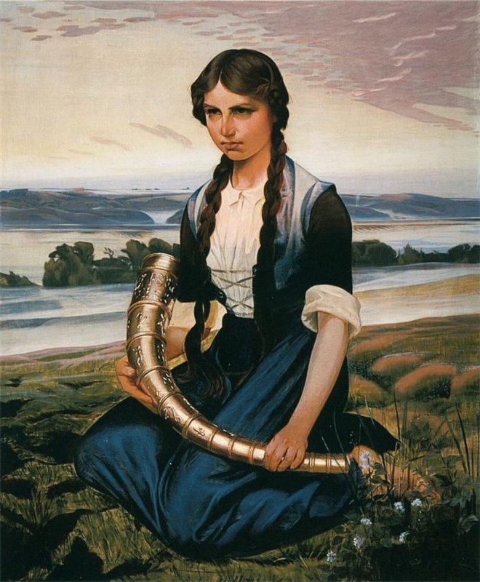

Slide 4
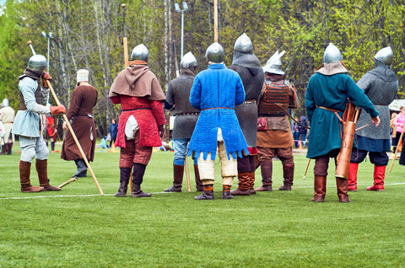
Today History is not something you read but something you do

Slide 5
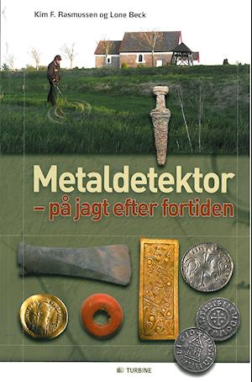
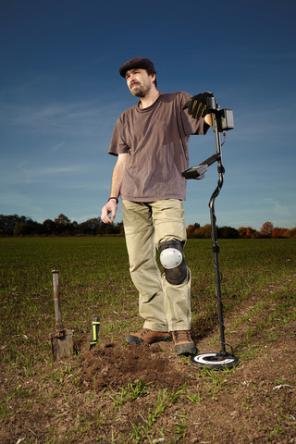
Then rings in the mould. The ancient gold.

Slide 6
Noting that the cultural heritage and the natural heritage are increasingly threatened with destruction not only by the traditional causes of decay, but also by changing social and economic conditions which aggravate the situation with even more formidable phenomena of damage or destruction,
First paragraph of the 1972 World Heritage convention

Slide 7
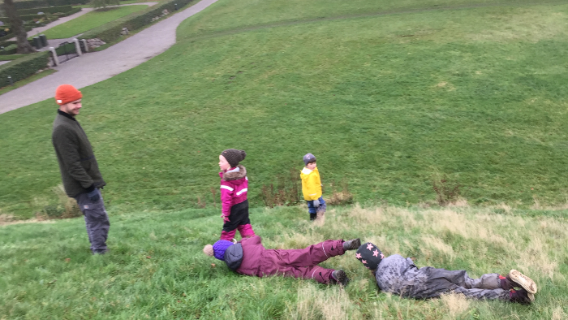
How to use World Cultural Heritage

Slide 8
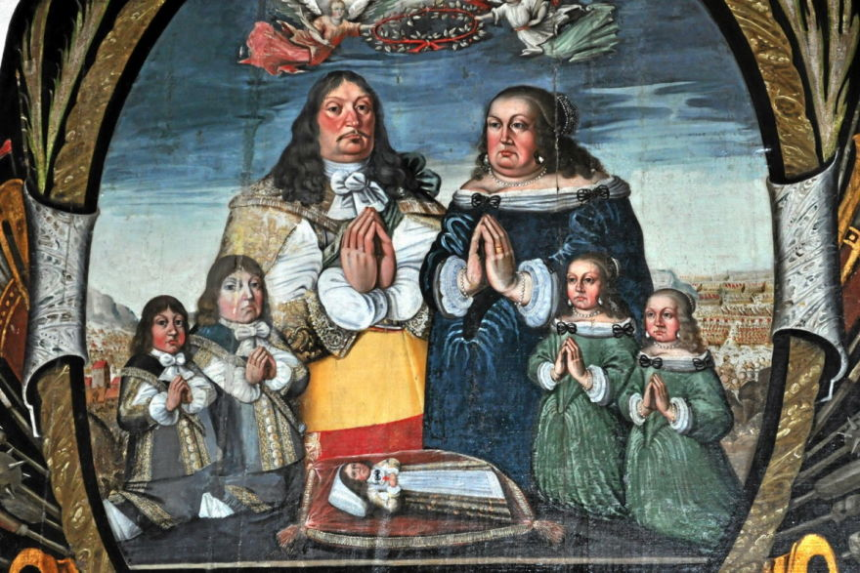
Smaller adults

Slide 9
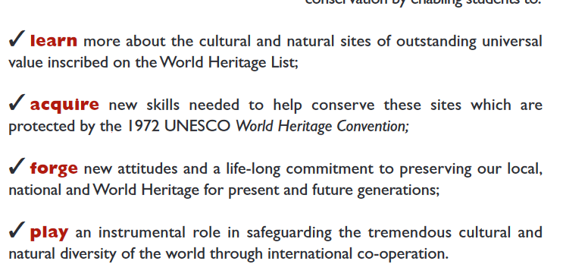

Slide 10
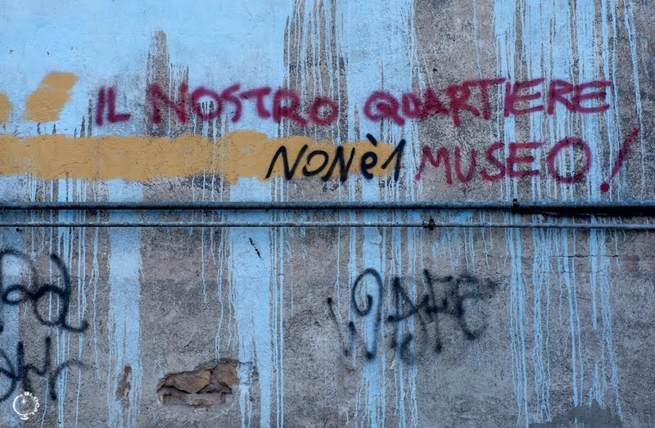
When in Rome… This is our Neighborhood NOT a Museum

