Slide 1
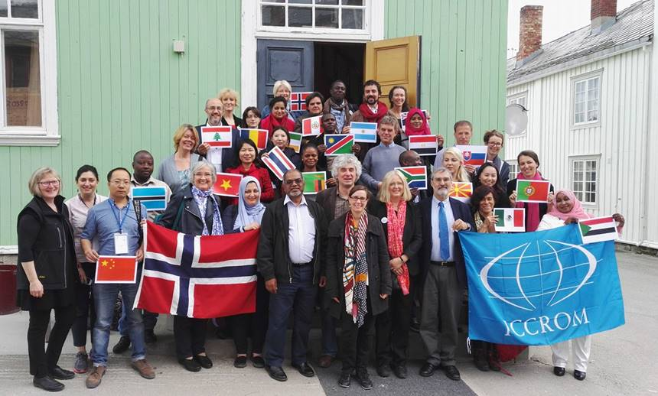
Nature, Culture, Communities
World Heritage Leadership Programme
A new capacity building programme of ICCROM and IUCN
Supported by the Norwegian Ministry of Climate and Environment
Notes:
This is a capacity building programme jointly delivered by ICCROM and IUCN, and it has been made possible with the generous support of the Norwegian Ministry of Climate and Environment.
I stress the capacity building objective of the programme, because it is formulated on the basis of getting people, as individuals and as collective institutions to make better informed decisions.

Slide 2
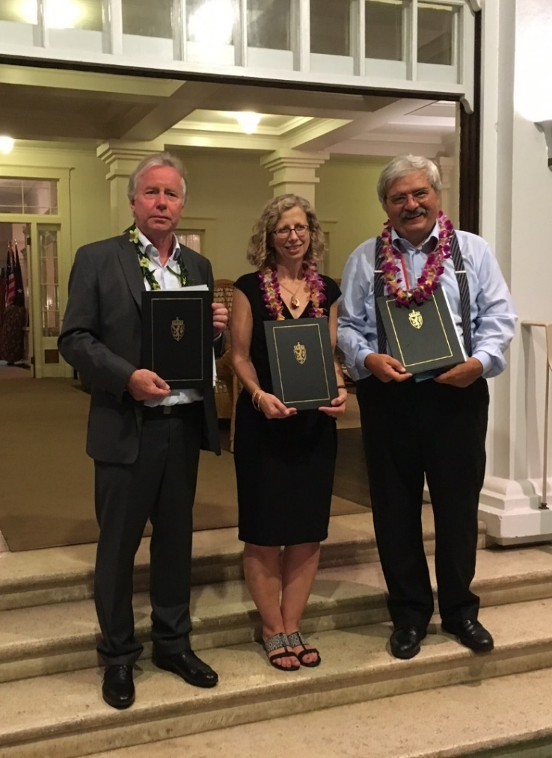
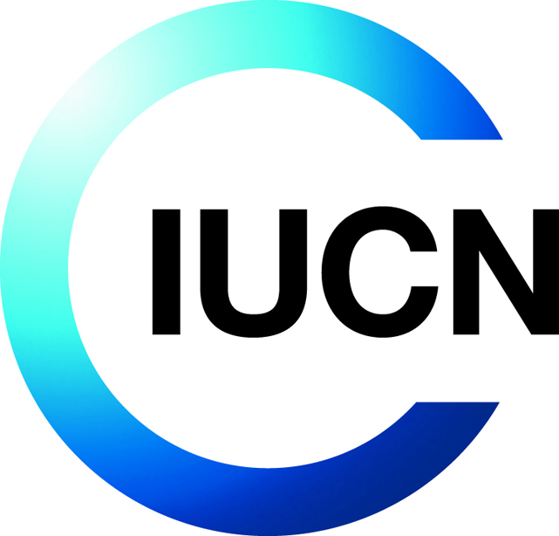
Culture and Nature: World Heritage Leadership
To improve conservation practice for culture and nature through the work of the World Heritage Convention, as an integral component of the contribution of World Heritage properties to sustainable development
Notes:
The World Heritage Leadership Programme aims to improve the overall heritage conservation practice, especially by linking nature and culture,
but it also aims to place people back into the framework of heritage conservation, so that World Heritage properties contribute to sustainable development, and play a vital role in society.

Slide 3
World Heritage Convention
The Convention is profoundly original in that it links together the conservation of nature and culture, thus challenging the limited perception that nature and culture are in opposition. Nature and culture are complementary, inseparable and interdependent, the cultural identity of different people having being forged in the environment in which they lived. Just as the creative works of humankind are often inspired by the beauty of their natural surroundings, some of the most spectacular natural sites bear the imprint of centuries of human activity.
Notes:
In essence linking culture and nature is more like returning to the fundamental principles of the 1972 Convention,

Slide 4
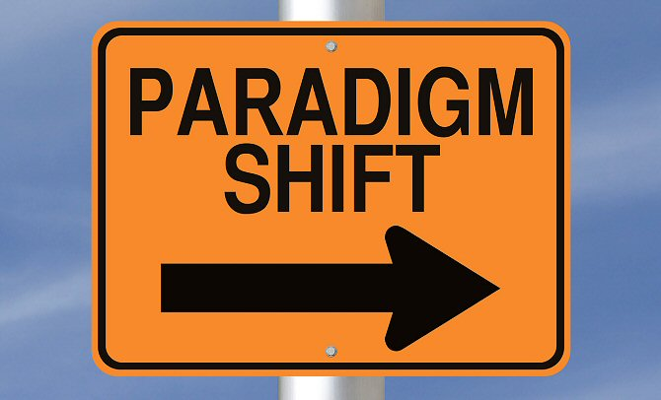
Paradigm Shift
From care of heritage to that of pursuing the well-being of both heritage and society as a whole
Notes:
Whereas placing heritage amongst its people, and to pursue the well being of heritage and society as a whole, is the paradigm shift that propels this programme.

Slide 5
Paradigm Shift
CONSERVATION PRINCIPLES
(WELL ESTABLISHED)
MONUMENTS
& SITES
Physical fabric
Impacts on heritage (only negative)
Results – interventions on heritage
CARE (WELLBEING) OF HERITAGE
CONSERVATION (EXPERT DRIVEN)
DIVERSITY AND CONTEXT
(EVOLVING PRINCIPLES)
HERITAGE
PEOPLE
Values (held by people)
Impacts on and of heritage (+ve & -ve)
Results for people, heritage, the environment
WELLBEING OF SOCIETY AND HERITAGE
MANAGING CONTINUITY AND CHANGE
(SOCIETY DRIVEN)
Notes:
In the past we persevered to protect the physical fabric of individual monuments and sites, and aimed to ward off any negative impacts onto the heritage itself, with the whole practice contained within the heritage experts and professionals.
However now we recognize that the values held by the people who are associated with the heritage is very important, and with the change of society, change in heritage is also inevitable. We cannot isolate heritage from the rest of the world, being contained in a vacuum of protection. But nor should we accept that any change can happen to heritage. Only as a society, can we manage the elements of continuity and elements of change for heritage, which would produce positive long-term impacts for both heritage and people.

Slide 6
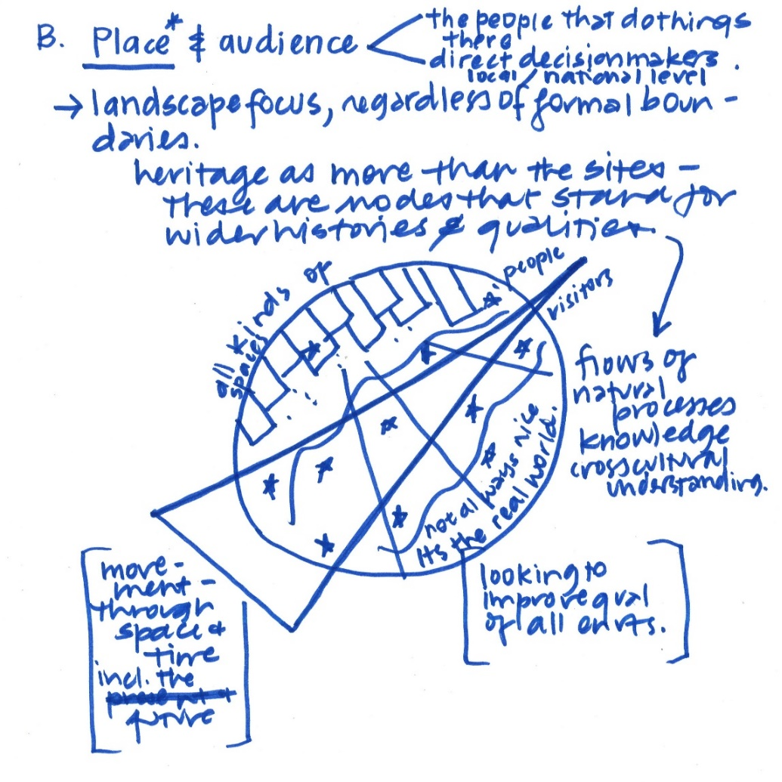
Understanding our Heritage Place – Setting
Site
Setting (Landscape or Seascape)
Connections
Heritage and People
Sustainable Development
Notes:
So throughout each activity, course, and workshop, we are continuously evolving to clearly identify our main target sites and audiences, to figure out the best way to reach them effectively. These are doodles that were produced out of a very intensive, professional brainstormings from the workshops that we have conducted.
Without understanding what the scope of our sites are, and who are audiences are, it is difficult to stay relevant and practical.
To make the culture-nature linkage be put into practice, it is important for us to recognize heritage as “places” where culture, nature and people all play a role.

Slide 7
Understanding our Audience
Notes:
And we are clearly aiming to target the site managers and the focal points for the World Heritage Convention as our main audience, because site managers are the key people who can bring about the most effective changes that directly impact the sites.

Slide 8
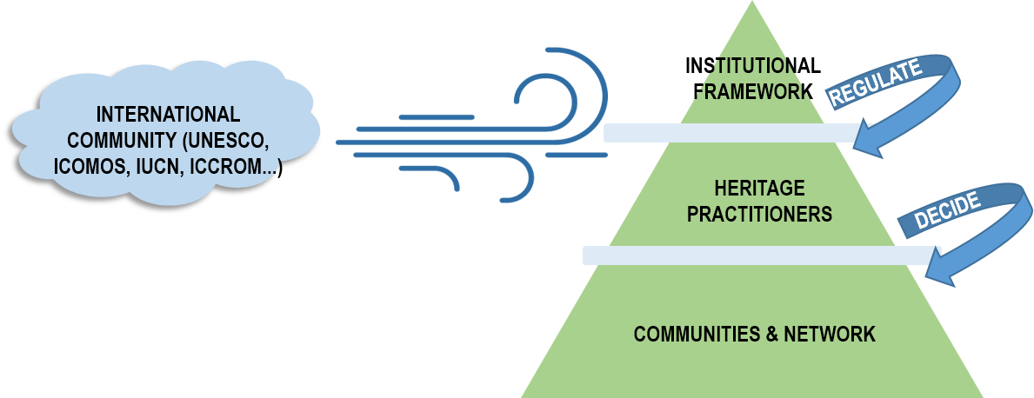
Understanding our Working Environment
Capacity Building on all areas to create an enabling environment

Slide 9
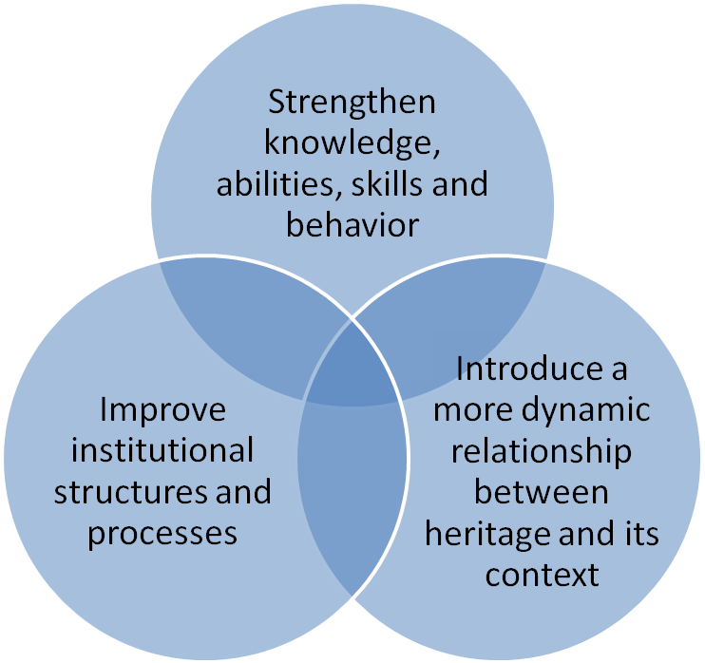
Capacity building
practitioners
institutional frameworks
communities & networks
http://www.undp.org/cpr/iasc/content/docs/UNDP_Capacity_Development.pdf
UNDP Capacity Development Practice Note, April 2006

Slide 10
Identifying where capacities reside and target audiences…
Where capacities reside and associated audiences:
Practitioners: Individuals and groups who directly intervene in the conservation and management of heritage
Institutional frameworks: Decision- and policy-makers in organizations with responsibility for the enabling environment for management and conservation
Communities & networks All those who have a legitimate interest in heritage
Some principal learning areas:
Implementation of the Convention for WH Conservation and management issues Technical and scientific issues Resource utilization and management
Policy-making for learning areas mentioned above Legislative issues Institutional frameworks/issues Resources (financial, human& intellectual
Reciprocal benefits and linking with sustainable development Stewardship Communication / Interpretation
…and corresponding learning areas

Slide 11
Creating a better working environment
INTERNATIONAL COMMUNITY (UNESCO, ICOMOS, IUCN, ICCROM...)
COMMUNITIES & NETWORK
HERITAGE
PRACTITIONERS
Capacity Building on all areas to create an enabling environment for heritage practitioners
INSTITUTIONAL FRAMEWORK

Slide 12
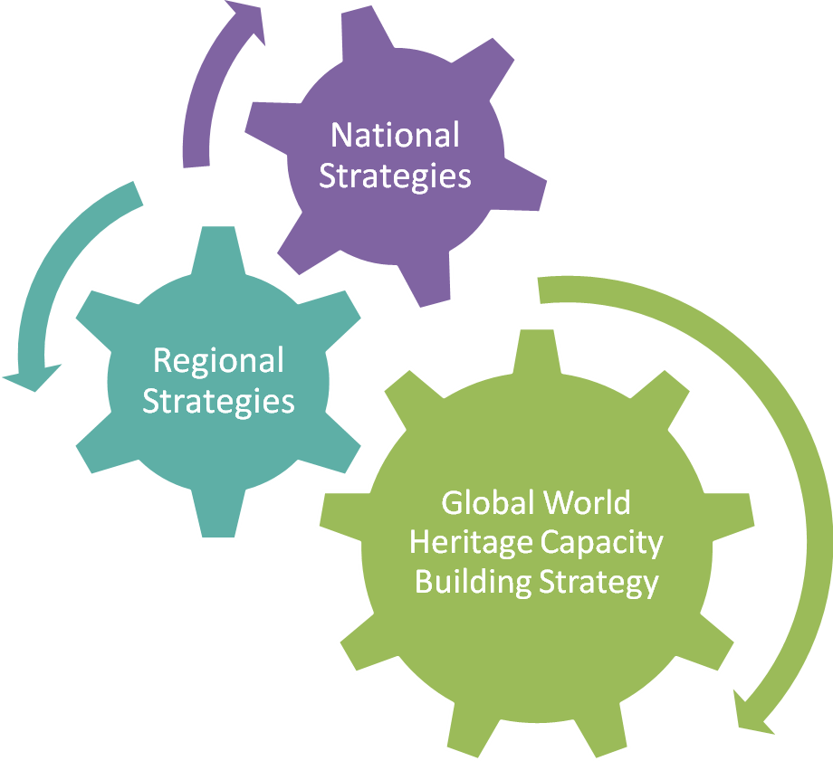
Strategies at 3 different levels
Site managers
Government bodies (local, national)
International entities
Experts
Local and wider communities
c a p a c i t y b u i l d i n g
c h a n g i n g a u d i e n c e s , n e w l e a r n i n g e n v i r o n m e n t s

Slide 13
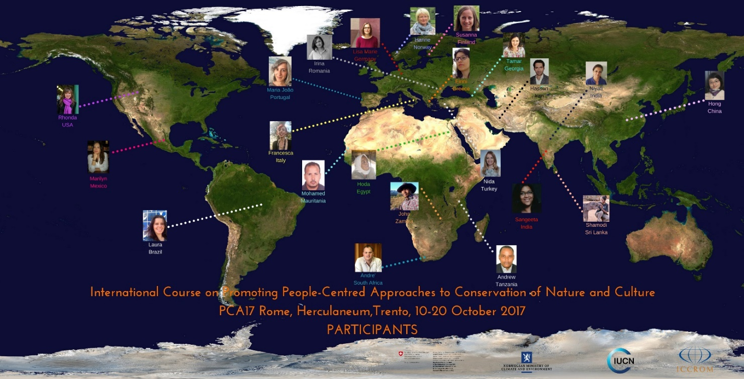
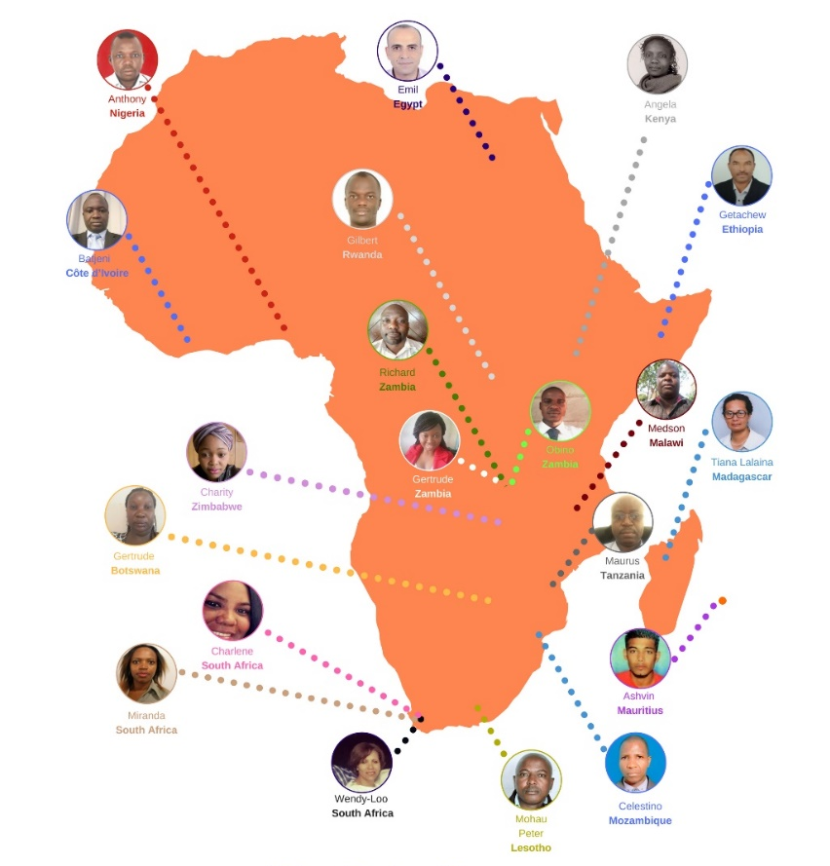
Leadership through networking

Slide 14
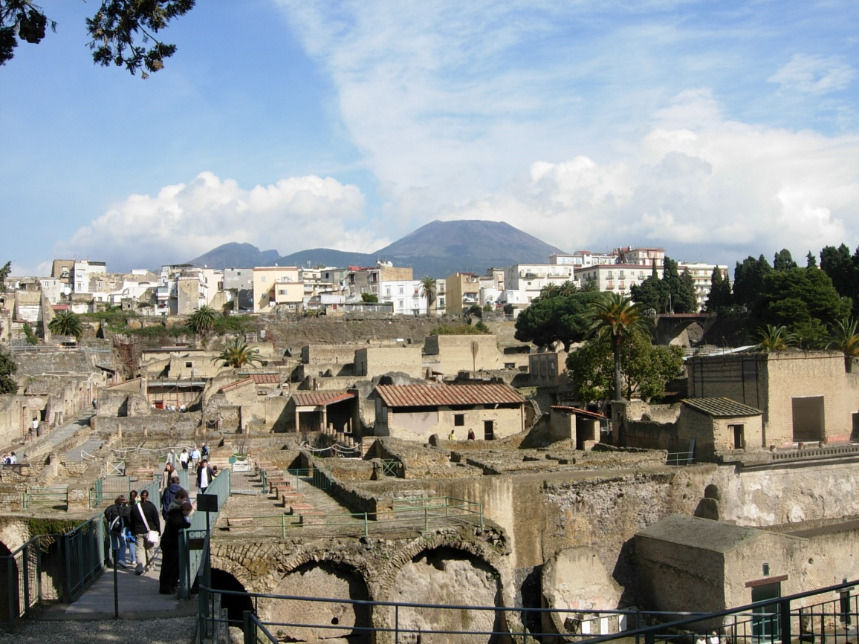
Areas of Learning
Effective Management: Nature, Culture, Communities
Resilience
Impact Assessment
Learning Sites
Leadership Networks
Notes:
The entire programme is composed of 5 modules. Effective management nature, culture, communities, Resilience, impact assessment, learning sites and leadership networks.

Slide 15
Thematic modules
6 years - 3 Work Programmes (2016 – 2022)
Effective Management:
Culture, Nature, Communities
Resilience
Impact Assessment
Integrated resource platform for management of
WH Culture and Nature
Revised Disaster Risk Manual for management of
WH Culture and Nature
Prepare Toolkit for Impact Assessment and WH as an international standard
Management Effectiveness Testing –Adapting the Enhancing our Heritage toolkit for cultural sites
DRM Training Course on site level – prepare DRM plan at individual sites
Capacity building activities on Impact Assessment
Integrated training courses on linking
People/ Nature/Culture
Guidance on Climate Change Adaptation
Improve communication strategy with IA experts
Notes:
This is a glimpse through some of the activities that will be implemented under each module. The entire programme will run for six years, with 3 work programmes in 2 year packs. We are now entering year 2 of the programme.
The main overarching module is the one on Effective Management: Nature, Culture, Communities. It is the very core of the whole programme. Various capacity building activities such as training courses, research and teaching collaboration with World Heritage master course universities are underway, and will continue on. There are also efforts to lead international standards on management, by producing an integrated management manual for nature and culture, and conducting management effectiveness tests on different types of sites. The first year has focused on building up a common ground, to identify pertinent issues that would be covered in the forthcoming manual.
The second module focuses on resilience. Heritage and society are prone to disasters and the effects of climate change, and it is necessary to identify risks and be prepared for them in advance to minimize the negative impacts and to be able to deal with the change. As IUCN WH Outlook has highlighted, climate change is the factor that has been the biggest factor of causing impacts on heritage conservation. It is already incurring changes in conservation practices on the ground, with materials and durability aspects being greatly affected. There needs to be a practical guidance on climate change adaptation which can be of genuine use to the practitioners on the ground. And this will be in conjunction to disaster risk preparedness. Long term DRM courses which will work on developing actual DRM plans for individual sites will be coordinated, together with a revised manual on DRM. We are also going to work on coordinating the overall manual with the resilience manual, so that it wouldn’t be overlapping or contradicting each other, but rather work as a complementary guidance.
The third module is on impact assessments. With the growing importance of conducting impact assessments for developments and change, we need to understand the broader scope of these assessments and to provide guidance to those who needs to commission the task, and also those who undertake the task. There is also the very large possibility of utilizing impact assessment as a proactive management tool. For this we will continue to work within the heritage sector, but also to reach out of our world, now liaising and seeking collaboration with the International Association of Impact Assessment, to produce a more practical toolkit for heritage.

Slide 16
Operative modules
Learning Sites
WH sites as learning labs demonstrating good practice in planning, governance, and management
Convening capacity building courses, management effectiveness testing, DRM planning
Leadership Networks
Relationship of individuals to the group or collectivity needs to be addressed, as individuals can act in ways that strongly influence others to follow suit in an enabling environment, becoming powerful agents of organizational and societal change.
Leadership Forum, and networking of Programme participants
Notes:
Whereas the first three modules are the main themes or areas of work, the other two modules are more of the working structure of the programme – demonstrating the site base approach and targeting of diverse audiences.
The whole program will base its work on individual sites. Courses, capacity building activities, planning, management effectiveness training will all be applied to sites and will work on actual site based examples. These sites will become learning sites, not necessarily being named as sites of good practice or bad practice, but as exemplary sites which could highlight the diverse important aspects of the objectives.
The idea of the leadership network is to support the able minded individuals to influence their way of work within their environment. We aim to reach out not only to site managers, practitioners, academics, government focal points, but also to those outside our heritage sphere, professionals of impact assessment, urban planning, rights based approaches, climate change and disaster risk preparedness. We aim to work together with those who can connect the dots and make a network that can influence our way of work.

Slide 17
Timeline of work
Build structure of capacity building online platform
Compile Resilience manual and IA toolkit
Develop EOH toolkit
Create task teams for Management manual, Resilience manual, Impact Assessment toolkit
Launch capacity building online platform
Publish Resilience manual and IA toolkit
Year 1
2016-2017
Year 2
2017-2018
Year 3
2018-2019
Year 4
2019-2020
Year 5
2020-2021
Year 6
2021-2022
Launching of WH Leadership
Implement capacity building activities aligned with platform and manuals
Link sites and managers through Leadership Forum and Learning sites
Convene International, regional courses and thematic workshops
Review and evaluate programme

Slide 18
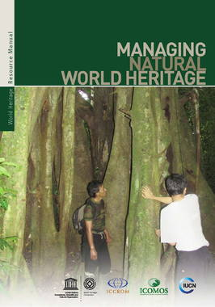
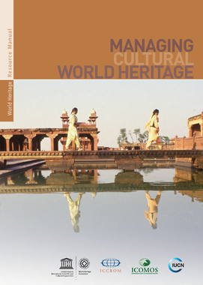
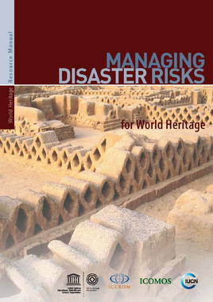
Original Expected Outputs
Joint integrated manual for managing cultural and natural heritage
Revised manual on disaster risk management incorporating natural heritage
Toolkit on impact assessment
Improved tools for evaluating management effectiveness
Improved teaching materials
Capacity building activities for variety of audiences
Creation of Learning sites and Leadership Networks
Notes:
These are the original outputs that we had set out, at the beginning.
The Programme initially had aimed to produce a joint integrated management manual for culture and nature, but as a result of our recent programme discussions, we have now evolved into building up a capacity building online platform, where we can also diversify the method of our delivery and reach out to a wider audience more effectively.

Slide 19
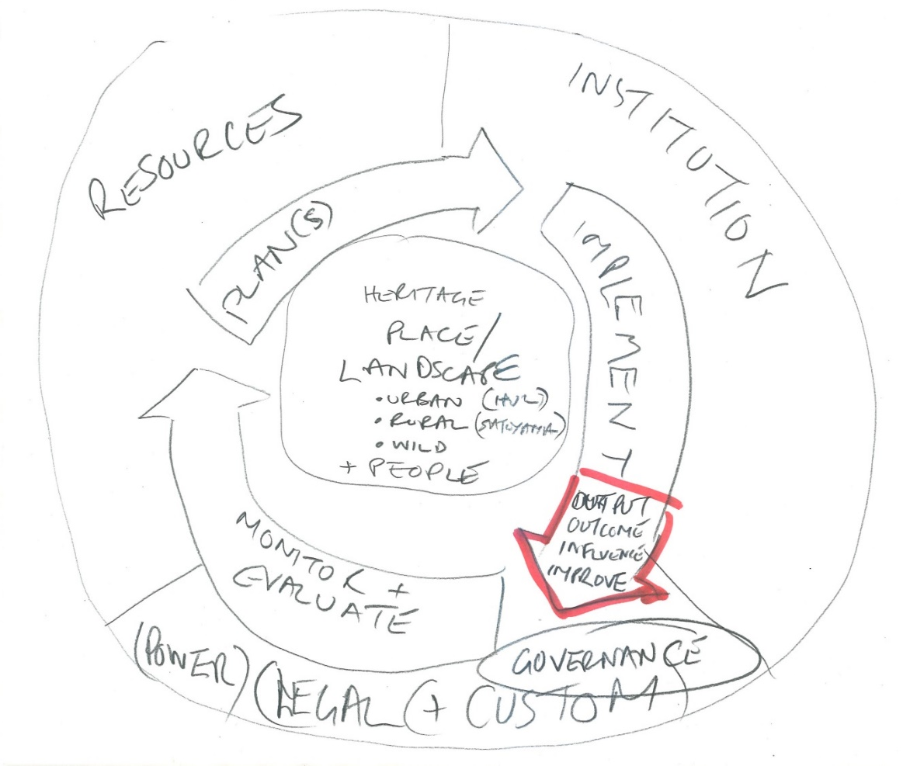
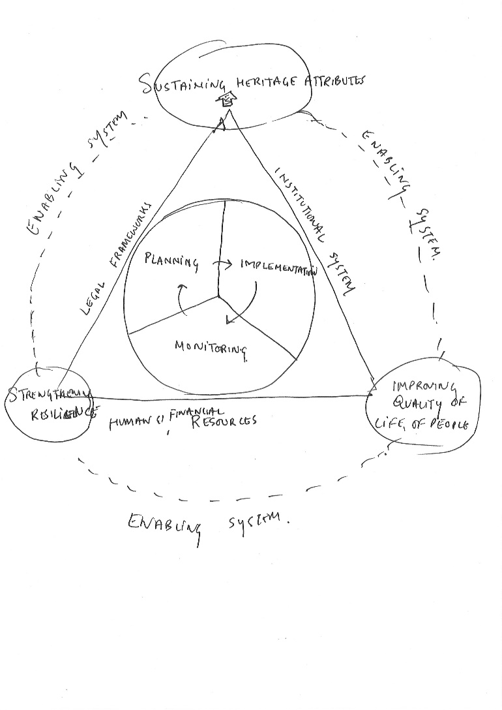
Resilience as part of Management

Slide 20
Staying Positive
Notes:
Although we aim to have a wealth of information and materials kept handy and easily accessible, we also recognize the importance of keeping it simple!

Slide 21
Expected Outputs – Evolved
Heritage Management
Resources Platform
General Policy
Strategies
Management Overview
Specific Themes
Procedures
Tools
Case Studies
Existing Manuals
+ Read me, prequels
Diagrams
Conceptual basis
Videos / Animations
Diagrams / Statistics
Interactive tools
Networking forum
Notes:
Hopefully after 6 years, in 2023, we will be able to present a joint resource platform for managing cultural and natural heritage, which will host all the necessary content of the integrated culture and nature management manual, a revised manual on disaster risk management, a toolkit on impact assessment with an array of capacity building activities delivered in many different medium.

Slide 22
Keeping in Mind
Good existing resources of manuals and tools
“Manuals” still valid and useful
Translations ongoing in many countries
Let’s not move the goal post too often
Existing tools need to be tested, used and disseminated rather than creating new tools
Better delivery : current resources mostly in the form of publications
Difficulty of locating the right material within context
Notes:
Hopefully after 6 years, in 2023, we will be able to present a joint resource platform for managing cultural and natural heritage, which will host all the necessary content of the integrated culture and nature management manual, a revised manual on disaster risk management, a toolkit on impact assessment with an array of capacity building activities delivered in many different medium.

Slide 23
The core message we want to deliver
Landscape approach to management of Heritage Places with natural and cultural values
People-centred approaches to management and rights
Resilience addressed both in daily context and specific issue areas
Notes:
Hopefully after 6 years, in 2023, we will be able to present a joint resource platform for managing cultural and natural heritage, which will host all the necessary content of the integrated culture and nature management manual, a revised manual on disaster risk management, a toolkit on impact assessment with an array of capacity building activities delivered in many different medium.

Slide 24
Issues to address
Content
Format
Notes:
Hopefully after 6 years, in 2023, we will be able to present a joint resource platform for managing cultural and natural heritage, which will host all the necessary content of the integrated culture and nature management manual, a revised manual on disaster risk management, a toolkit on impact assessment with an array of capacity building activities delivered in many different medium.

Slide 25
Content Production
Existing content
Manuals, publications, booklets, guidance notes, tools
Adapted content
Updating existing materials
Specific worksheets, read-me docs, booklets, diagrams, infographics
Developing new content
Through Programme activities of WH Leadership
Notes:
Hopefully after 6 years, in 2023, we will be able to present a joint resource platform for managing cultural and natural heritage, which will host all the necessary content of the integrated culture and nature management manual, a revised manual on disaster risk management, a toolkit on impact assessment with an array of capacity building activities delivered in many different medium.

Slide 26
Content Format
Animations, Short videos, Ted Talks
Text, PDFs, books with read-mes
Visual materials, diagrams, statistics,
Printable Leaflets
Interactive worksheets, exercises, tools
Thematic bibliography
Dripfeed tasks
All accumulated in an Online platform with a site map to locate the right material in context of the whole range with multiple entry points
Notes:
Hopefully after 6 years, in 2023, we will be able to present a joint resource platform for managing cultural and natural heritage, which will host all the necessary content of the integrated culture and nature management manual, a revised manual on disaster risk management, a toolkit on impact assessment with an array of capacity building activities delivered in many different medium.

Slide 27
Technical Format
Where do we host? What platform to use for the online aspect
Development of website – Sustaining the website
Daily maintenance of structure – Keeping it alive with marketing and community building
To maintain quality of data and efficiency of producing results
Lifespan of platform
Notes:
Hopefully after 6 years, in 2023, we will be able to present a joint resource platform for managing cultural and natural heritage, which will host all the necessary content of the integrated culture and nature management manual, a revised manual on disaster risk management, a toolkit on impact assessment with an array of capacity building activities delivered in many different medium.

Slide 28
Keeping it Alive
Promoting the use of content
Feeding in new content
Long term maintenance of platform
Human, financial, technical resources
In house, outsourced
Notes:
Hopefully after 6 years, in 2023, we will be able to present a joint resource platform for managing cultural and natural heritage, which will host all the necessary content of the integrated culture and nature management manual, a revised manual on disaster risk management, a toolkit on impact assessment with an array of capacity building activities delivered in many different medium.

Slide 29
Community Building
Building a community before the platform
Use existing social networking platforms (facebook, linked in..)
Two way communication
Community to contribute to building the website
Marketing the content to the community to promote the use of website
Notes:
Hopefully after 6 years, in 2023, we will be able to present a joint resource platform for managing cultural and natural heritage, which will host all the necessary content of the integrated culture and nature management manual, a revised manual on disaster risk management, a toolkit on impact assessment with an array of capacity building activities delivered in many different medium.

Slide 30
Online learning research
ORGANISATION/COURSE | PLATFORM
UNITAR (United Nations Institute for Training and Research) | Moodle*
Tourism Management at UNESCO World Heritage Sites | FUN (FRANCE UNIVERSITE NUMERIQUE)*
PAPACO | Courseware*
FAO E-LEARNING | FAO E-Learning Platform
THE LENS | UNESCO Website
PANORAMA Webinars | Panorama website/GoToMeeting/Youtube
Several institutions are currently using BLACKBOARD* and FUTURE LEARN*.
While the former is accessible only through formal registration by the course organizers, Future Learn offers free courses that are open to everyone.
*: digital education platforms that offer courses by different universities and institutions
Notes:
These are the original outputs that we had set out, at the beginning.
The Programme initially had aimed to produce a joint integrated management manual for culture and nature, but as a result of our recent programme discussions, we have now evolved into building up a capacity building online platform, where we can also diversify the method of our delivery and reach out to a wider audience more effectively.

Slide 31
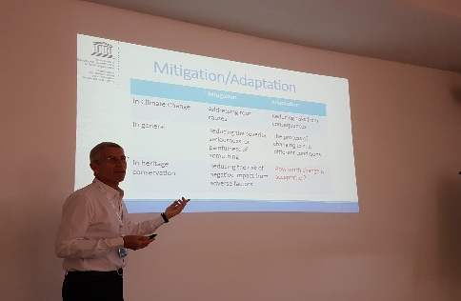
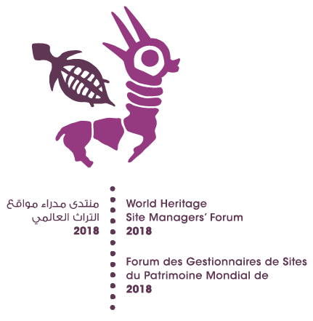
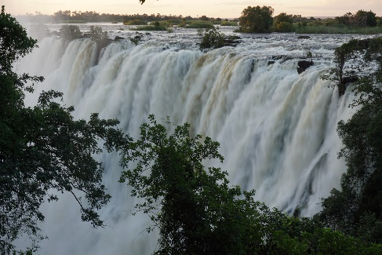
Recent Activities
Enhancing our Heritage Toolkit application
April 2018 – Jan 2019
ARC-WH, 12 WH sites in the Arab region
Workshop on Resilience, Climate Change and Disaster Risk Management
4-6 June 2018
ICCROM
Site Managers’ Forum
in conjunction with the 42nd WH Committee meeting
June 21-28 2018
Manama, Bahrain
Africa Regional Course on People, Nature, Culture
August 14-24 2018
Mosi-oa-Tunya / Victoria Falls, Zambia
Notes:
The Nordic Experts Course is aimed at building the capacity of Nordic experts on the specific processes of the World Heritage Convention concerning evaluations and monitoring. This will be held in Bergen, Norway for a week, and we would like to ask for as much participation from competent experts in the region who wish to be better acquainted and involved with the World Heritage system. The deadline for applications are set at May 25, so please check out the ICCROM website.
This October we have a course on impact assessments being held together with WHITRAP in China. The announcement has been made and applications are being received, so if you would like more information and knowledge about applying impact assessments, please check out the ICCROM website, course announcements.

Slide 32
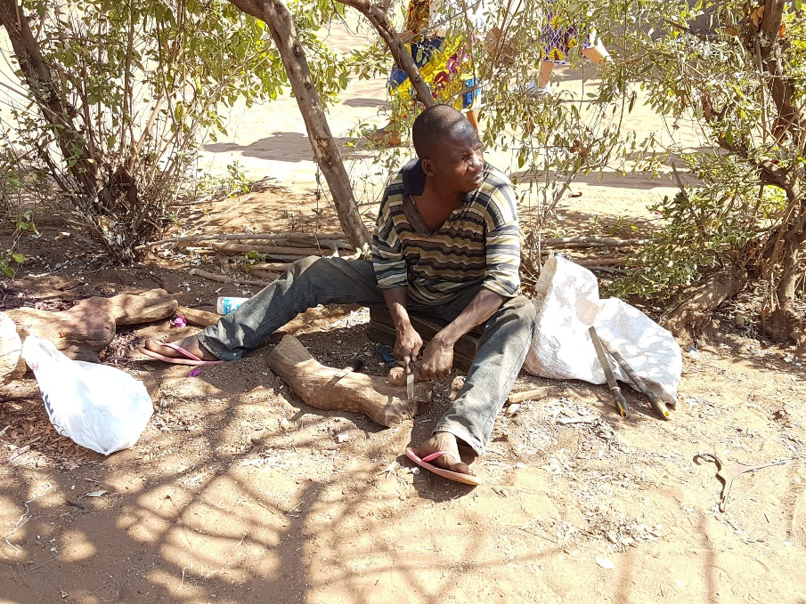
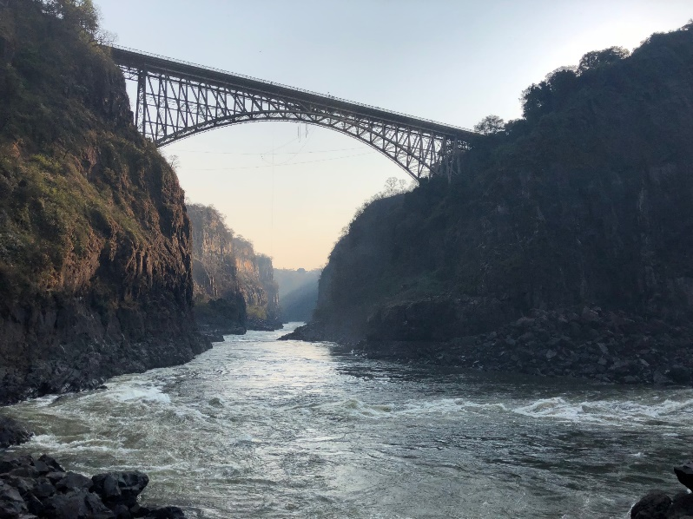
PNC18 Mosi Oa Tunya

Slide 33
PNC18
Participants articulated the need to be better at measuring the benefits and impacts of sustainable development
Indicators of sustainability
Social development
(Number of women involved in the economic endeavors
Economic development
(Number of locals employed within the site
Environmental sustainability
(Carrying capacity on heritage resources)

Slide 34
Site Managers Forum – Statement of Participants

Slide 35
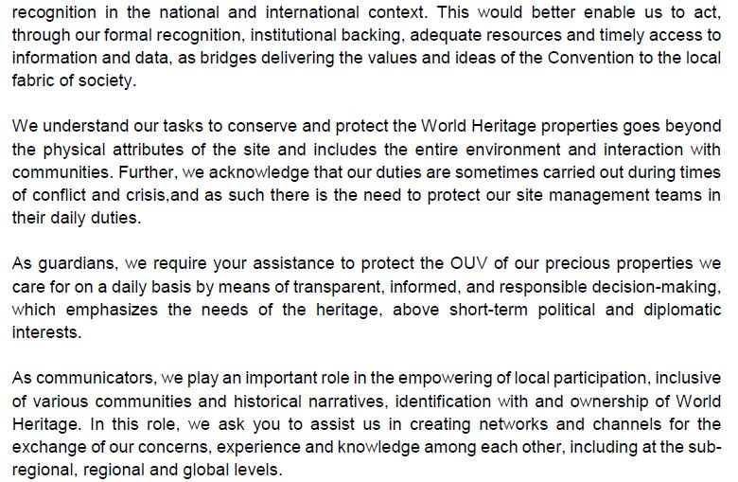
Site Managers Forum – Statement of Participants

Slide 36
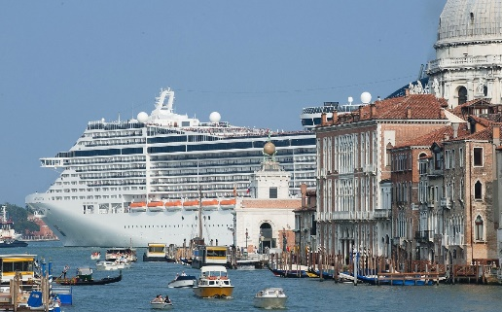
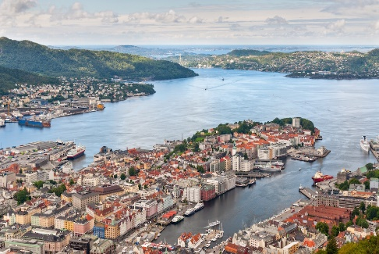
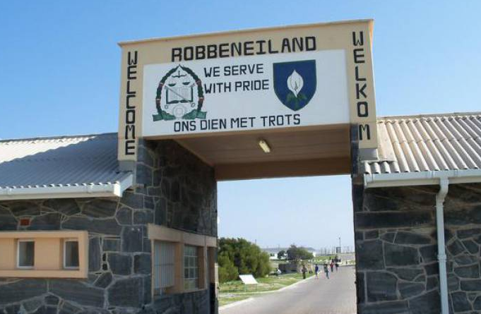
Upcoming Activities
Workshop on Impact Assessment
September 10-12, 2018
IUCN
Nordic Experts Course on Processes of the WH Convention
September 24-28 2018
Bergen, Norway
Course on Impact Assessment for Heritage (with WHITRAP)
October 15-24 2018
Shanghai and Zhenze Town, China
Development and application of the Enhancing our Heritage Toolkit
October / November
IUCN / Robben Island, South Africa
Notes:
The Nordic Experts Course is aimed at building the capacity of Nordic experts on the specific processes of the World Heritage Convention concerning evaluations and monitoring. This will be held in Bergen, Norway for a week, and we would like to ask for as much participation from competent experts in the region who wish to be better acquainted and involved with the World Heritage system. The deadline for applications are set at May 25, so please check out the ICCROM website.
This October we have a course on impact assessments being held together with WHITRAP in China. The announcement has been made and applications are being received, so if you would like more information and knowledge about applying impact assessments, please check out the ICCROM website, course announcements.

Slide 37
Plan forward
Continue to identify key issues that needs to be practically addressed for Site Managers and Focal Points
Provide a well structured platform to link the needs and the necessary materials
Sustain the network of practitioners to maintain the validity and utility of the platform content by disseminating the message through various different capacity building activities

