Slide 1
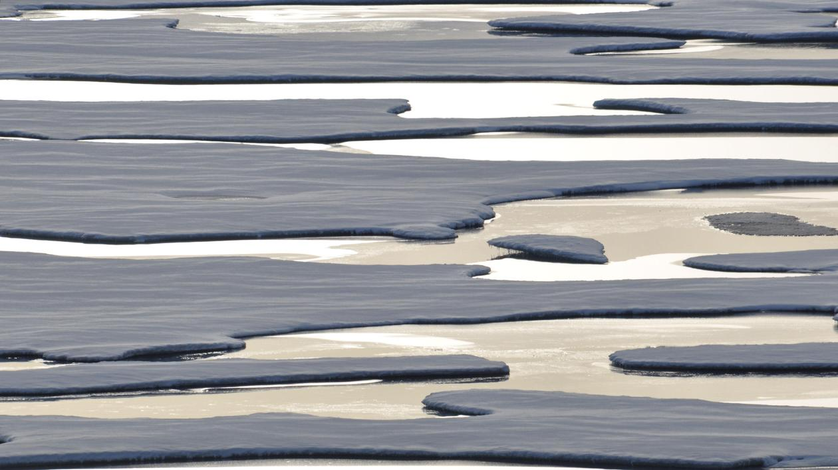
Climate change Climate change the last ten years
I will start with an article in the KNR's morning radio newspaper on August 22 this year.

Slide 2
Environment · August 22, 2018 · 08:18 by Karsten Sommer High temperatures in the Arctic in February and now again in August have gained some of the world's most solid sea ice, north of Greenland, to melt and drive away from the coast. Share on Facebook Share on Twitter Share on Google Email this article to a friend Print the page "It has not been seen before that part of the ocean has opened up, says Professor Sebastian H. Mernild from the Norwegian Center for Climate Research, to TV 2. The sea ice north of Greenland is otherwise considered as the last sea ice that will be left at all if climate change and rising temperatures begin to melt the sea ice in the Arctic. This year, however, something has happened quite unusual. READ ALSO This year's sea ice sets the turbo to the south In the midst of the Arctic winter, a rare weather phenomenon occurred, where there were suddenly ten days of plus degrees in February. On August 3, the phenomenon repeated itself with temperatures up to 17 plus degrees and a strong warm wind from the south. The ice is now blown farther from the coast than you ever have experienced since the 70's, where you began to monitor the area with satellite imagery. READ ALSO The Hague in the Arctic remains at record low level. "Although the ice should freeze to already within a few days, the damage has already occurred. The thick old sea ice has been pushed away from the coast into an area where it will smoother, says Thomas Lavergne from Norway's Meteorological Institute to The Guardian. End of the quote.
For about 10 years ago the winters were very mild. Autumn usually arrives in mid September. And sneezing already falls by that time, but it is not allowed to lie. It will get a little cold in the month of October with snow approx. -10 degrees. And we will think the winter has come to stay. But at the beginning of November it will be very mild about 0 degree. Some times up to approx. 10-11 degrees warm. This turns the temperature around the freezing point, a little colder other times a bit warmer. First at the start of February are there cold and snowed landscape. But that can not be left because the wind blows the snow almost all the time. And we got hot right early in the spring already in April, melting a lot of snow away. In the May month, there will snow a little bit. And at the end of May it was really hot summer. The temperature is approximately 10 degrees hot to start with and mid June, temperatures rise to 15-20 degrees hot and last until late July or mid August. Then the temperature drops quickly to 5-10 degrees but still feels warm when there are sun. The night freezing was quite early in September. And that use to happened year after year until 2015 The winters became a bit colder - not much. Sea ice is almost never to stay. If it happened, it is no more than a couple of weeks.
30 years ago we had winter temperatures around -25 degrees or slightly colder one to two months or maybe 3 months, we only have these temperatures for a couple of three weeks now.

Slide 3
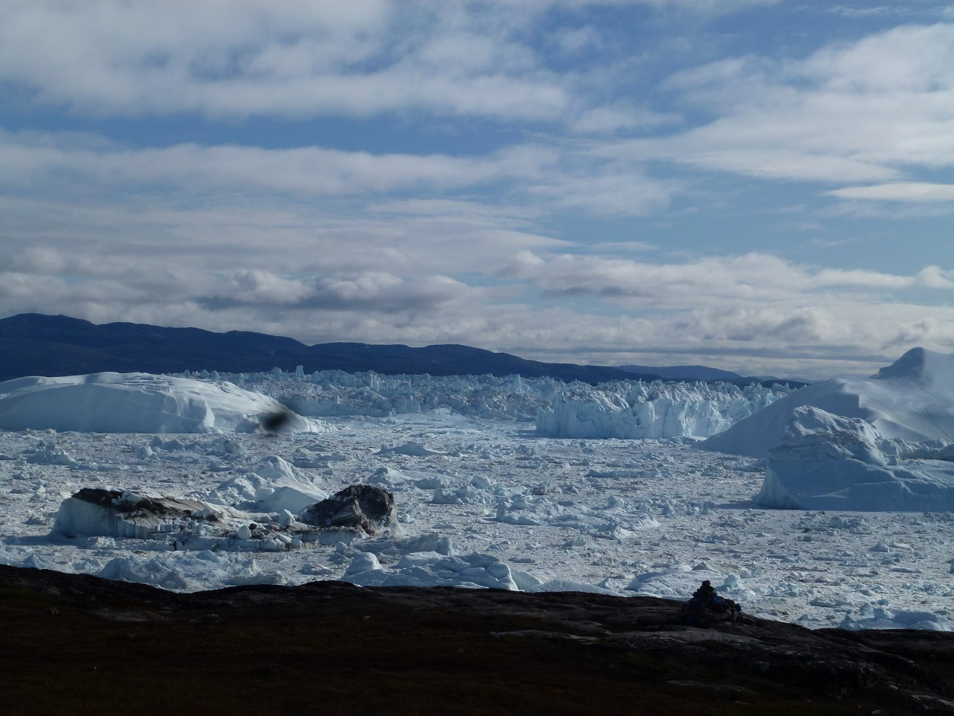
The last three years in the winter the snow came right early - September or October. And there is a lot of snow and feels a lot colder. And so, it usually lasts all winter until late May and it is as if snowfall gets more violent every winter. The summer heat lets you wait the last 3 summers. Only late June or the beginning of July will the snow will disappear completely. And the temperature lasts only at 10 degrees and very very rarely up to approx 15 degrees. And especially this year is the summer extra cold we got in Greenland. The temperature makes around the 5 degrees and fairly evenly up to 10 degrees. So we don’t have a global warming the last 3 years.

Slide 4
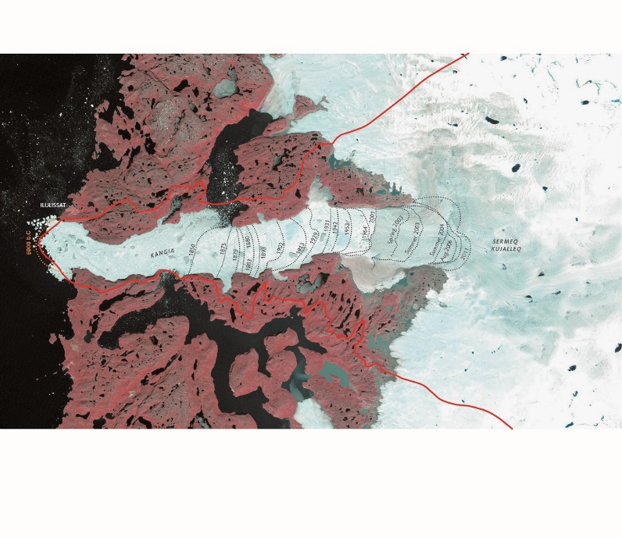
The icebergs with tips upward are becoming a sight-seeing. The last Iceberg like this we saw was in about2010. And only now they are coming again.
In 1850 was the Glacier only 22 km away from Ilulissat. It was first time some body started to remark the place of the Glacier. And now 168 years after, the Glacier is about 70 km´s away. Maybe we can see there, that the Climate change already started 19th century in 1850. Now I show the map which tell us, how the Glacier how always had moved back to the land. From 1850 to 2001 disappeared about 30 km Glacier, and after 2001 climate change speeded up to now, so the last 20 to 25 km Glacier disappeared in only for 15 years. The current place of the Glacier is standing for last 3-4 years but calving of the Glacier continues to North behind the the peninsula Nunatarsuaq.

Slide 5
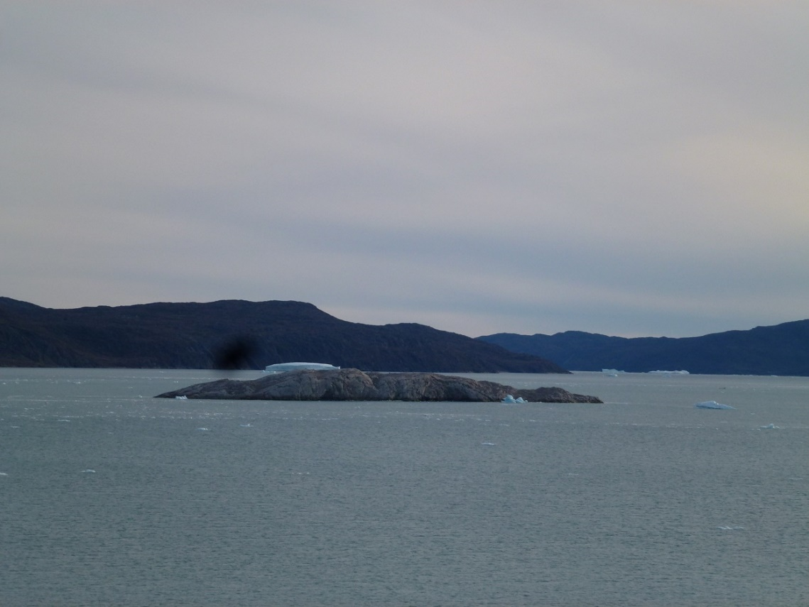
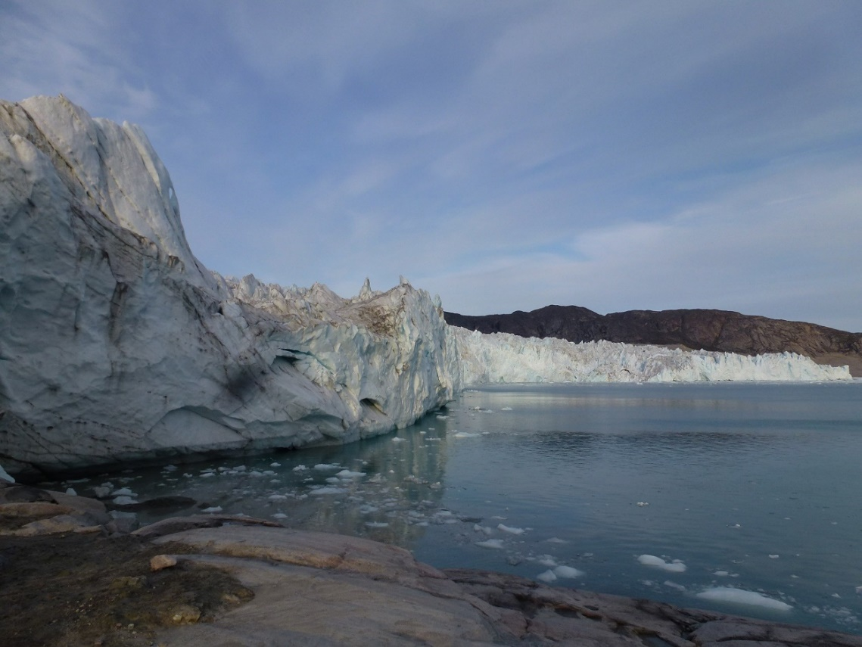
The Norther Glacier ”The dead Glacier”
Now I Will show a Picture of the Island that war covered of Glacier the Year 2000. Now it is about 4-6 kms away from the Glacier.

Slide 6
Mess Tourism
You can find Mess Tourism also in Ilulissat. Cruise Ships are comming to Ilulissat in summer 2018 59 times. The Ships can have 19280 passengers total. The Ships can have passengers from smallest ships of 100 passenger to the biggest Ship with 1180 passengers.
The Ships are from Bahamas, Norway, Germany, Portuguese, Italia, France, Marshall Islands, USA and Canada.
Hotels
Numbers of staying overnights in Hotels i Qaasuitsup kommune from Greenland Statistik was
2012 approximately 75000
2013 approximately 74000
2014 approximately 71000
2015 approximately 79000
I don’t have Numbers from 2016 to now. But that seems to be almost the same numbers of tourists staying overnights in Hotels. So there are a lot of searches for our Sermermiut.
Most in summer half-year but also some less in winter half-year.
When the cruise passengers come to the landing in the harbor, they run up to the Wooden bridge and go to Sermermiut settlement and takes pictures of Icebergs and come back to Harbor and back to the Ships again, most of them. Of course some of them buy some souvinirs and maybe eating at the Restaurants before they left and go back to the Ships.
The Ships are comming 2 to 3 some times 4 ships in same day. So there are comming too many tourist’s at Ones. But it is okey we have too many tourists in 2 mounts in the year.
But there are many Hotel tourists most of the year. They are spending a lot of Money to business life in Ilulissat. That’s good for tax economy for Ilulissat.

