Slide 1
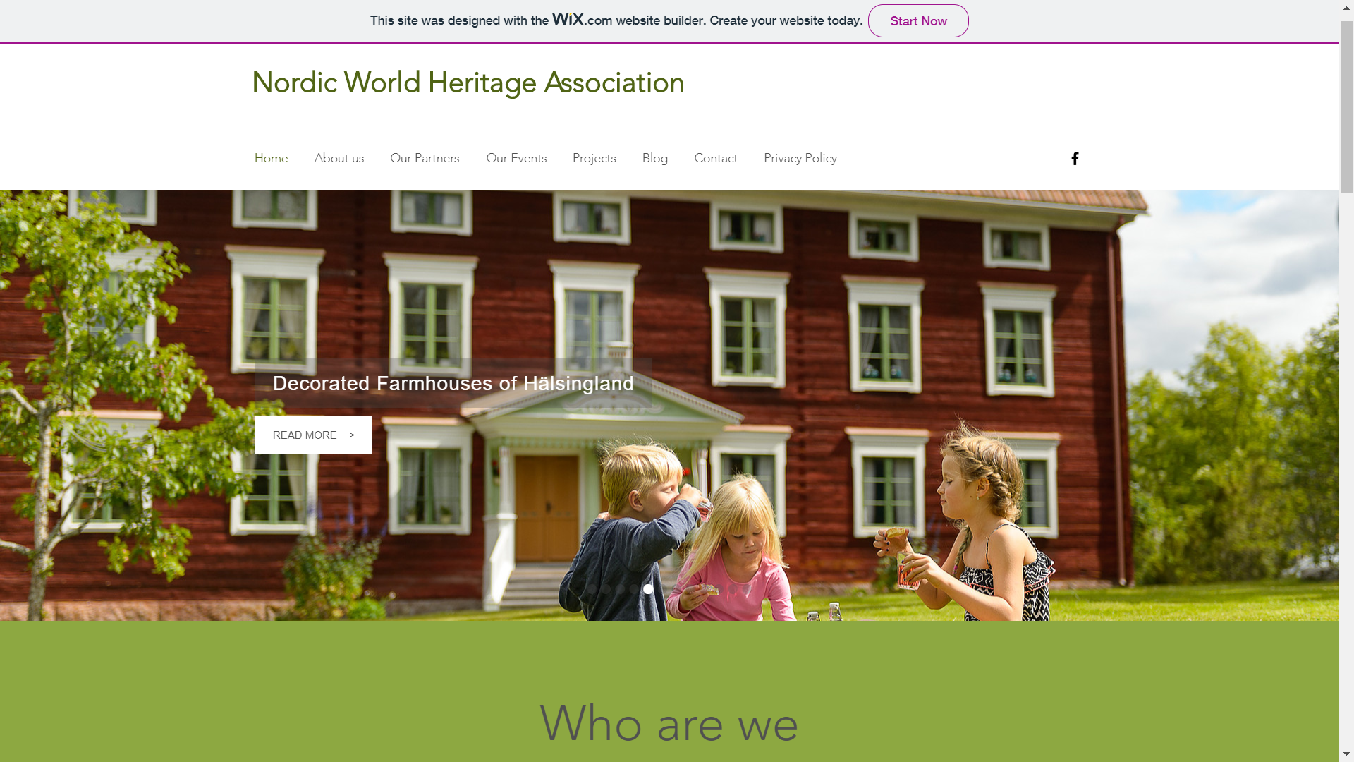

Slide 2
www.nordicworldheritage.org

Slide 3
The new platform for the association
Access to the board
Direct contact to all member associations
Overview of selected projects and events
Starting point to explore UNESCO World Hertiage

