Slide 1
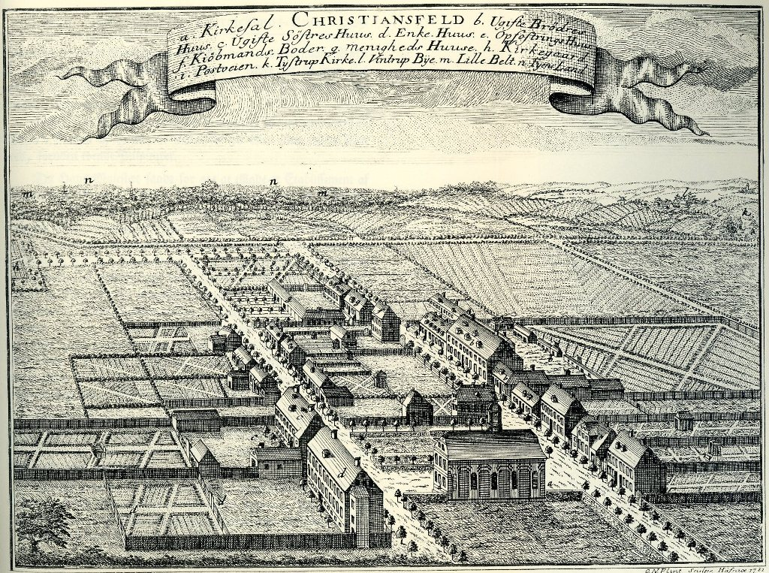
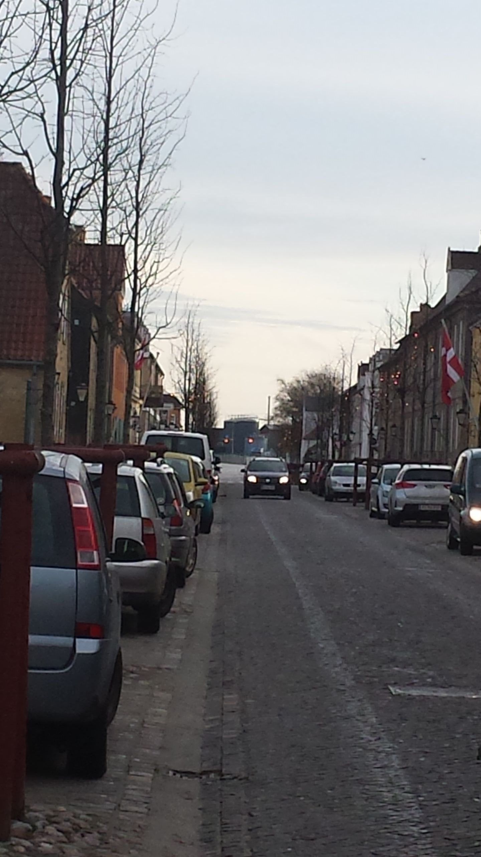
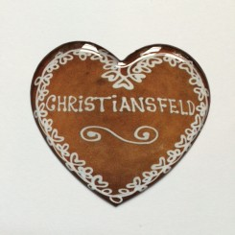
Cultural Heritage and Living religious communities
- The Moravian Settlement in Christiansfeld

Slide 2
Perspectives
Sites and buildings of religious communities can fulfill a dual purpose: cultural heritage for all and religious context for some.
“Whose heritage is being preserved and managed by whom, for what purposes, and with what political implications?” (Shepherd 2013, 24). With a specific emphasis on the role of living religious communities (interests, influence, impact etc.).

Slide 3
Global, national, regional, local – communities and identities
“Global heritage, I would posit, is not a thing per se, but a set of politically inflected material practices, whether one is talking about a World Heritage site, for example, or its governance through a set of international legal framings, translated and enacted at a national level and having devolved concrete effects for local residents.”
(Anthropology : Global Heritage : A Reader)(1). Wiley-Blackwell, 2015, Lynn Meskell.

Slide 4
Living religion at heritage sites
Sites, which include a living religious community are “simultaneously preserved and vibrantly alive” in the process of becoming a cultural heritage site (Shepherd 2013, 13, Faith in Heritage ) ..
Cultural heritage management is a context where religion is expressed, governed and shaped through the interaction between religious community and other agents.
The interaction between institutions of cultural heritage and religious communities presents a context of institutional intersections, where issues of religion are of special significance.
The religious traditions, rituals, dress codes, buildings and personal lives become assets in “cultural heritage” and thereby represent a value as living precious relics– but how is this value negotiated and by who?

Slide 5
Study of religion and/IN museums
Research project: Religion – Living Cultural Heritage (2019-2021, funded by Velux)
Material presence and the question of categories (religious, ethnographic, prehistoric or art objects?) (Clifford, 1988; Duncan, 1995; O’Neill, 2005; Paine, 2000, 2013; Bräunlein, 2011; Schütze, 2014).
Current/recent projects of the research team:
  Ph.d-thesis by Laura Maria Schütze (2014)
  Minor collaboration projects with museums and the Center for Contemporary Religion concerning exhibitions on religion/cultural heritage (Aarhus Bymuseum, Tønder Museum, Thisted Museum). (Director: Marie Vejrup Nielsen)
  Research into the management of churches in relation to tourism perspectives (Lisbet Christoffersen, 2015)

Slide 6
questions
What are the policies and practices involved in such processes and what can they reveal about the issues of interaction between religious communities and institutions of cultural heritage?
How is the public dimension of this meeting managed in relation to e.g. the influx of larger groups of tourists to a religious community site?
What structures and processes are invented or changed in order to govern this meeting?
How do processes of cultural heritage management affect the identity and life of religious communities and vice-versa?

Slide 7
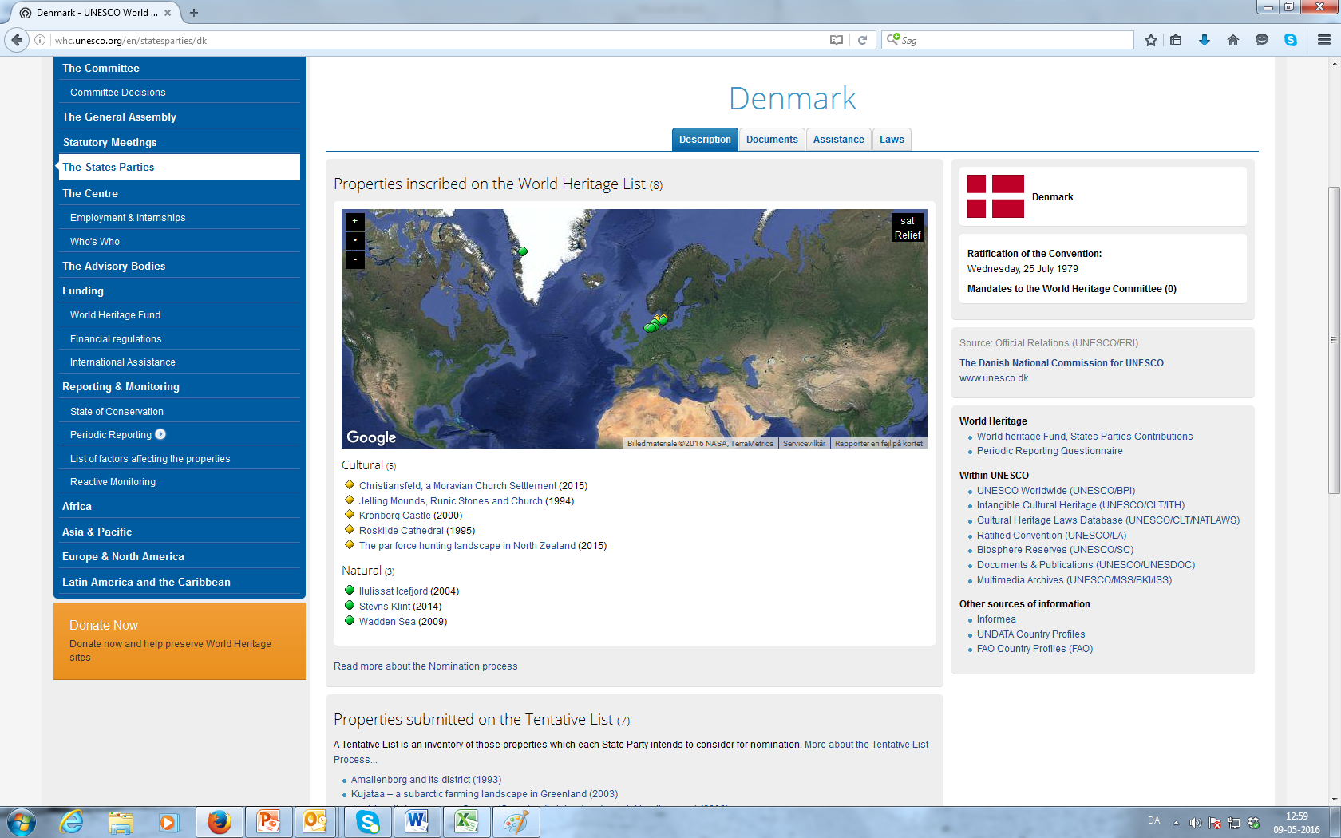
Danish World Heritage

Slide 8
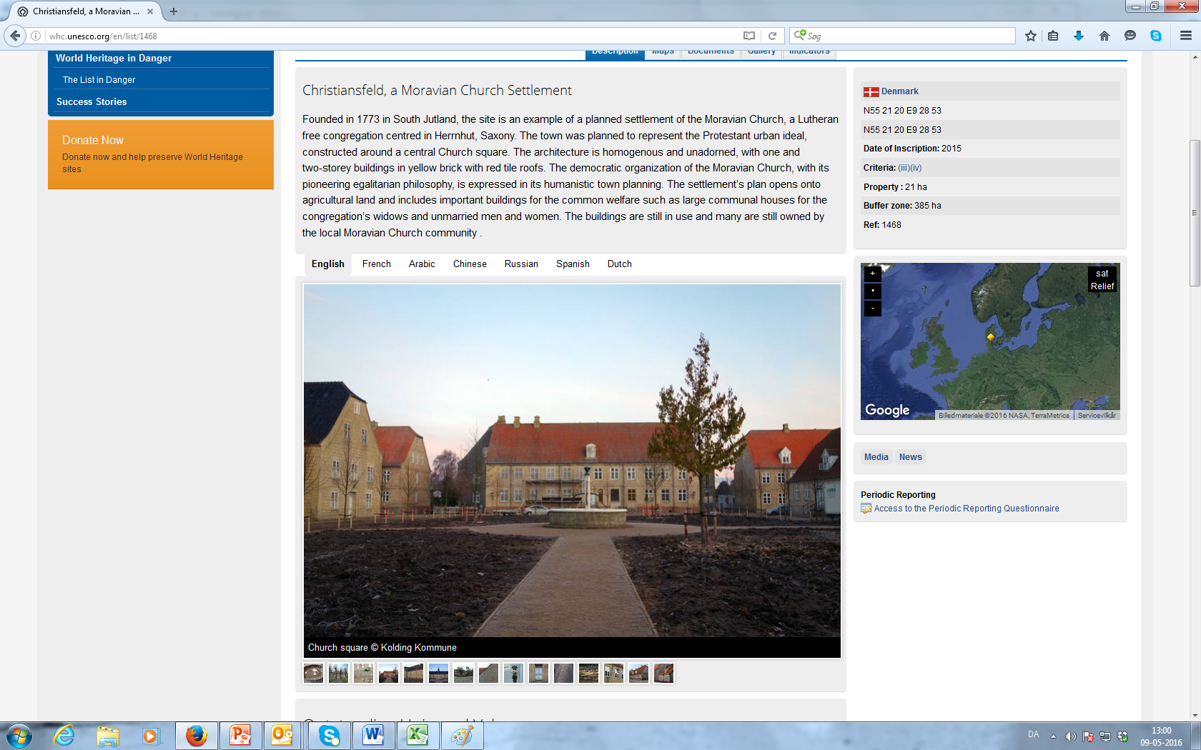
Christiansfeld

Slide 9
“Authenticity”
“The structure and characteristics of the original town plan remain largely unaltered. All buildings, especially those of the early Moravian period of 1820, retain their authenticity in material, design, substance, workmanship, and some of them as well in function and use. The continuity of the Moravian Church community contributes to safeguarding authenticity in spirit and feeling as well as atmosphere of the property. Most of the residential units have been modernized in their interiors to be in line with contemporary living standards whilst aiming to retain their authenticity wherever possible. In some cases architectural renovations could have been implemented with more respect for authenticity. At times architects have aimed for modern interiors of a high aesthetic standard and refinery which have unfortunately reduced traces of historic construction materials and techniques. It is recommended that future modernizations, including of interiors, should pay special attention to the preservation of historic surfaces.” http://whc.unesco.org/en/list/1468

Slide 10
”Protection and management requirements”
“The management plan predominantly aims at the preservation and protection of Christiansfeld with regards to its town plan, historic architecture and landscape setting. The plan combines a list of specific measures divided into three areas; urban, architectural and cultural, to be undertaken in the forthcoming four years. The current priorities and actions are intended to be implemented up until 2017, when a comprehensive evaluation and revision of the management plan is envisaged. Quality assessment indicators for the evaluation of its implementation are yet to be finalized. The management plan is yet to be officially adopted but the different actions contained in it have been endorsed by either the Kolding Municipality or the Management Group. The Moravian Church community remains very active in upholding its religious and social services. These also form opportunities for involvement in the social and ethical principles that underline the significance of the settlement.” http://whc.unesco.org/en/list/1468

Slide 11
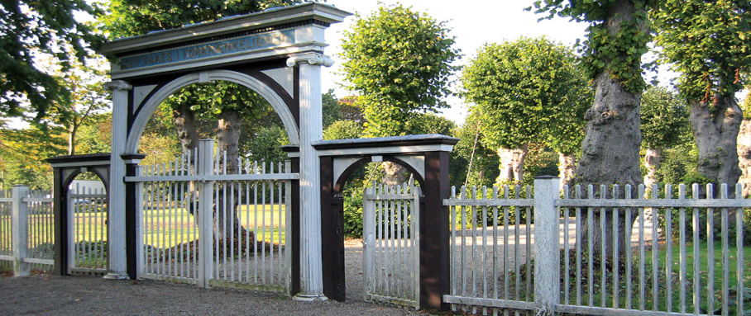
”A different kind of cemetery”
”Besøg en anderledes kirkegård (Gudsageren)
Gudsageren er Brødremenighedens egen kirkegård, hvor de afdøde hviler på samme måde, som menigheden sidder i kirken: søstrene til højre og brødrene til venstre. Alle gravsten er ens som symbol på, at alle er lige efter døden. Indskriften på stenene vender mod øst, og numrene angiver rækkefølgen af dødsfald i menigheden, fra det første i 1773 frem til i dag.” http://www.visitkolding.dk/danmark/architecture/christiansfeld

Slide 12
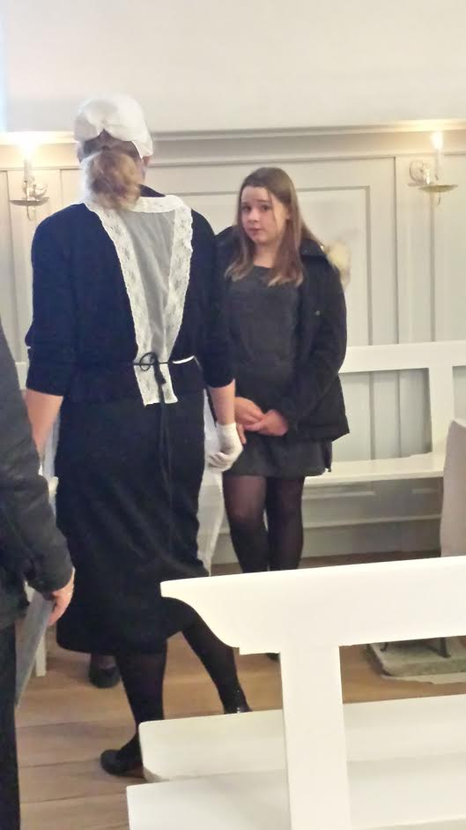
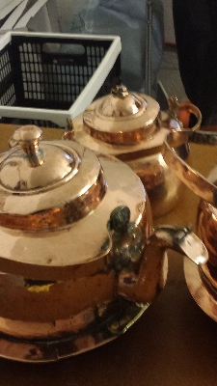
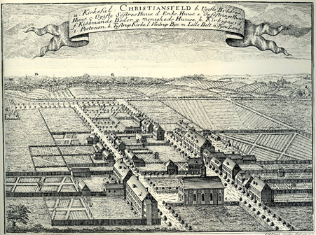
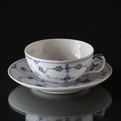
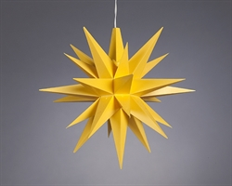
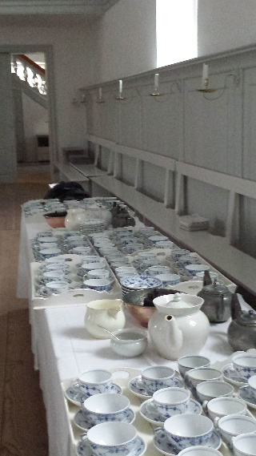
Moravian Materialities

Slide 13
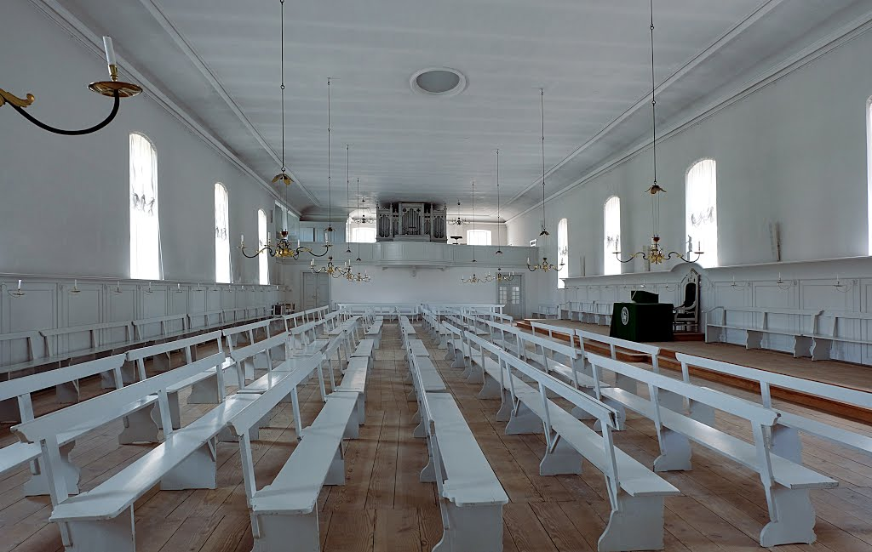
Living cultural heritage

Slide 14
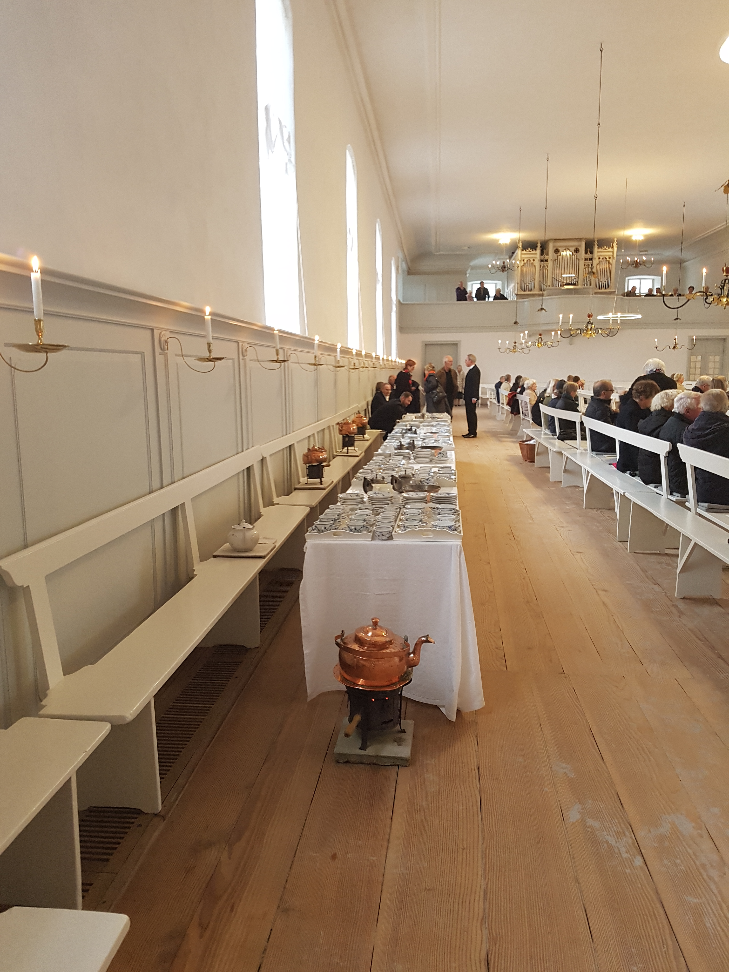
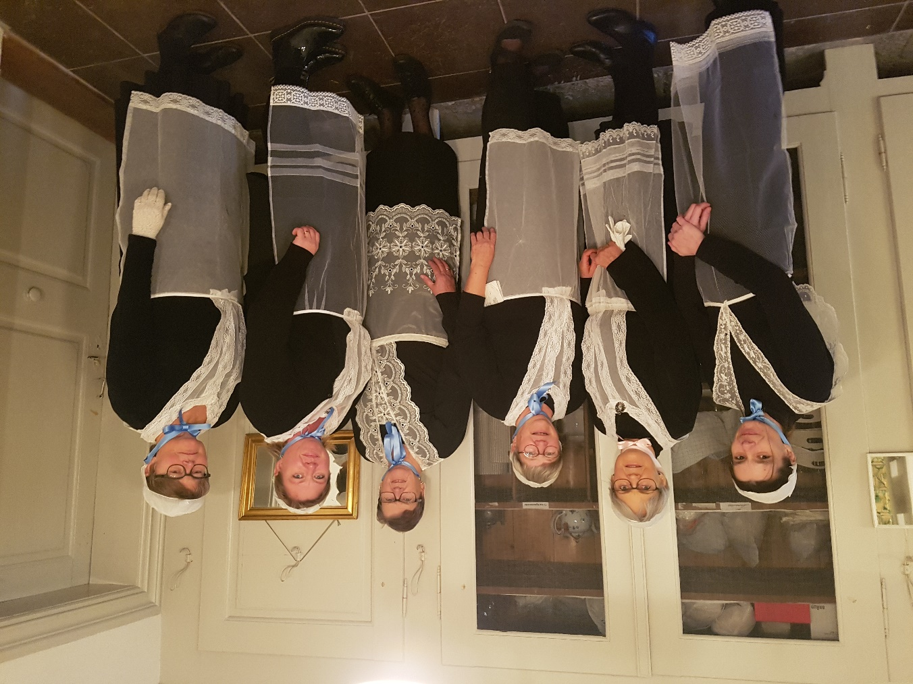
Living cultural heritage

Slide 15
Christiansfeld – Moravian community and heritage site
The religious ideas and traditions as central to the site and its continued existence –
  A town built on scriptural ideals.
The religious ideas manifest themselves in material culture and intangible practices
Some initial observations:
  The city and the congregation – two communities at the same site.
  The tourists and the congregation –
  The historical ”other” – the historical background and the issue of national heritage.

