Slide 1
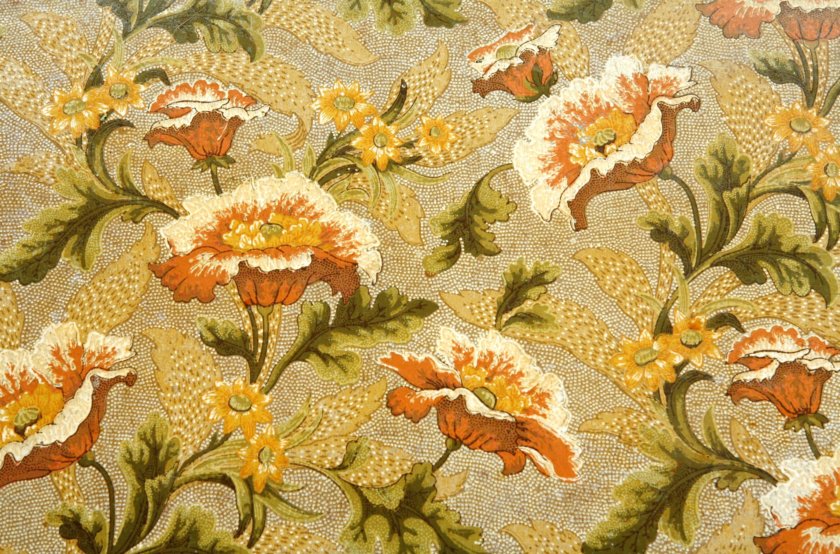
World Heritage Scholarship

Slide 2
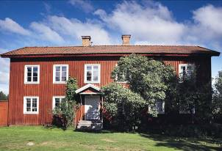
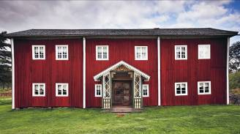
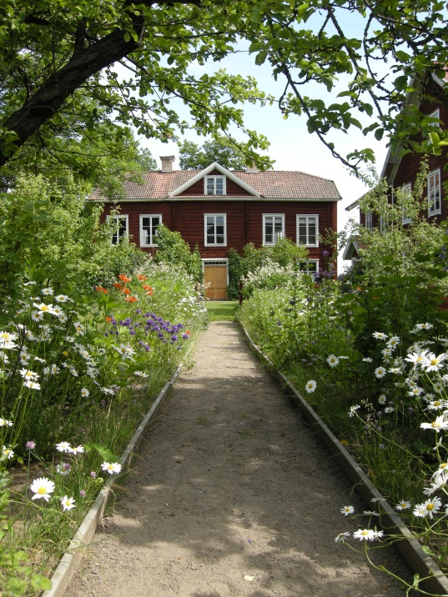
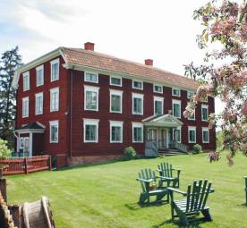
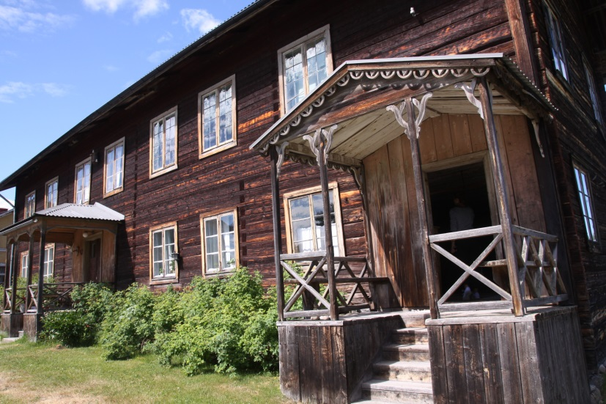
Kristofers in Järvsö Gästgivars in Vallsta Pallars in Långhed
Bortom åa in Fågelsjö Erik-Anders in Asta Jon-Lars in Långhed Bommars in Letsbo
The farmhouses of Hälsingland were listed 2012 under the name Decorated Farmhouses of Hälsingland.
Seven farms were chosen to represent the 1000 farms in the landscape.
Notes:
So The world heritage committee declared The Decorated farmhouses of Hälsingland to be a world heritage during the St: Petersburg meeting in 2012. The meeting was attended by regional representatives and the seven owners of the nominated farmhouses. The farmhouses of Hälsingland were listed 2012 under the name Decorated Farmhouses of Hälsingland.
Seven farms were chosen to represent the 1000 farms in the landscape.
The seven farmsteads were built in the early to mid 1800´s, a time of a big building boom in Hälsingland.

Slide 3
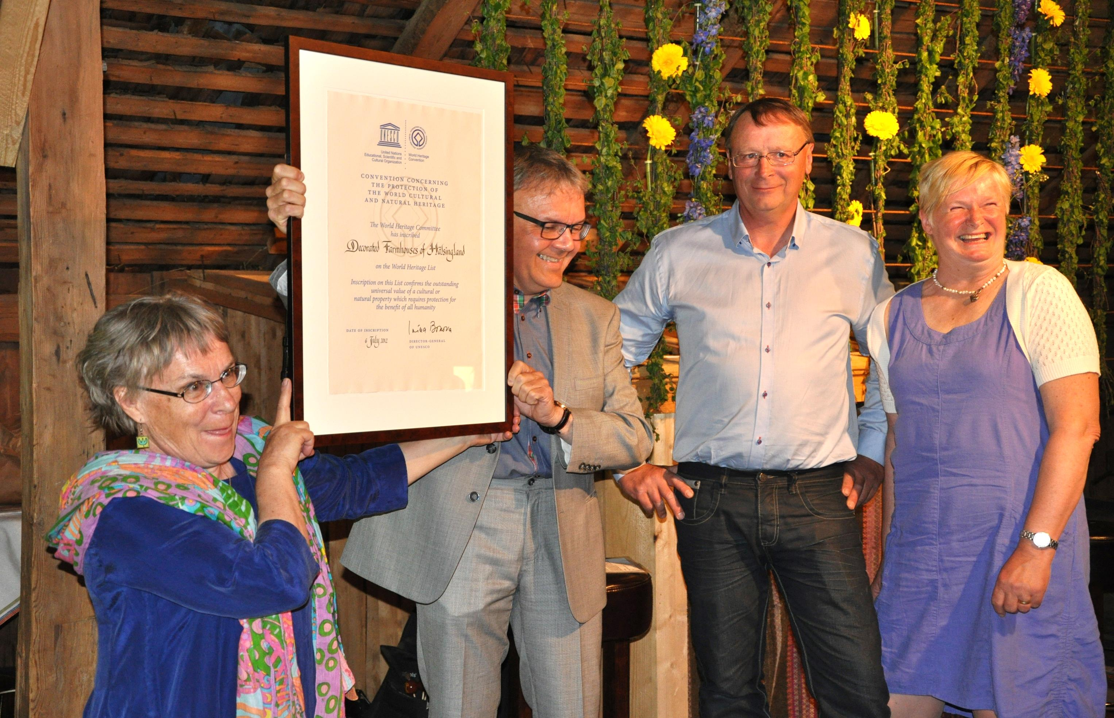
The Region of Gävleborg have several cultural scholarships.
Why not a scholarship for world heritage?
Notes:
The Region of Gävleborg have several cultural scholarships given out to people every year. and a year ago we started to discusse; wouldnt a scholarship for world heritage be a good idea?

Slide 4
The farmers built these magnificent decorated farmhouses just for grand feasts.
As here – a great wedding to show off to the world. Party for at least 5 days…
Notes:
The big and lavishly decorated farmhouses were used only a few occasions during a lifetime. The most important was the wedding party, that could last for at least 5 days. This was an opportunity for ordinary farmers to show off to the world.

Slide 5
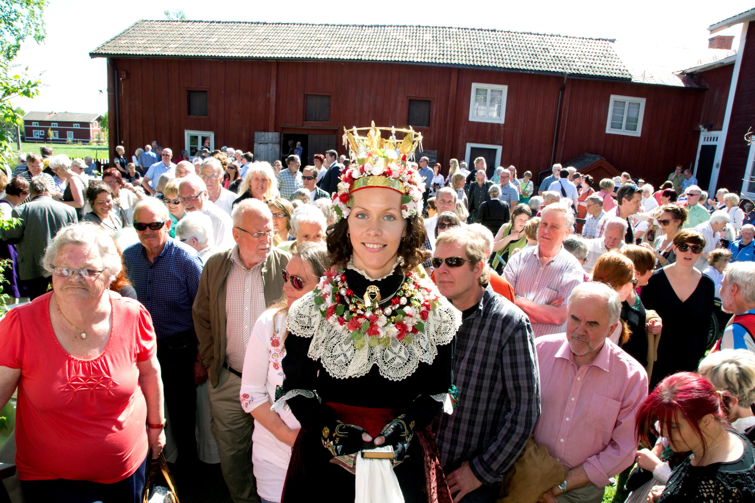
The World Heritage Scholarship invites the wardee to stay and work in one of the seven farms during one month from all around the world as an international scholarship.
Notes:
To a wedding - under these days - hundreds of guests were invited from near and far. The Guests stayed over, ate and drank consistently for days on end, in the beautiful rooms made for feasts. Rooms that afterwards stood empty until the next feast. The world heritage scholarship invites guests again to stay and work in one of the seven farms. Guests from all around the world as an international scholarship

Slide 6
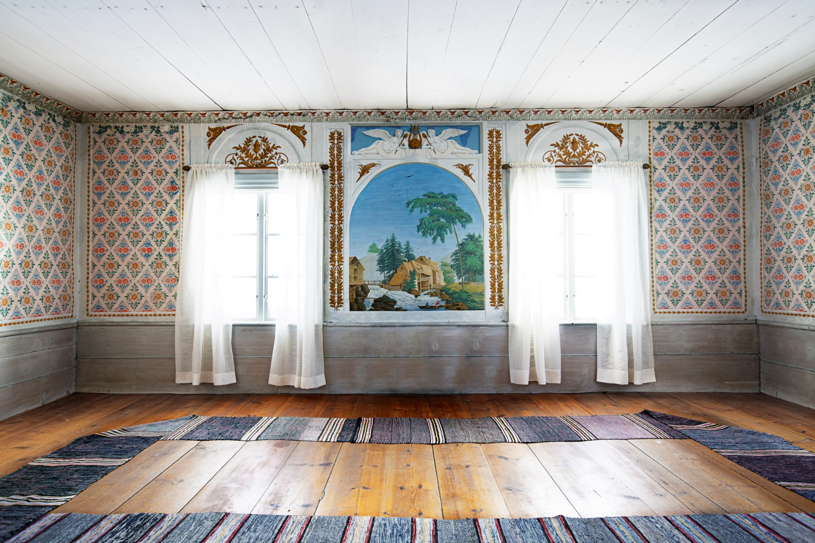
The purpose of the scholarship is to widen the context of the Decorated Farmhouses of Hälsingland - all in the spirit that expires the UNESCO intentions - to build bridges between people and other World Heritage sites.
Notes:
The purpose is to widen the context of the world heritage Decorated farmhouses of Hälsingland in the form of artistic practice, advancement or skills raising/researching exchange; all in the spirit that expires the UNESCO intentions. To build bridges between people and other world heritage sites.

Slide 7
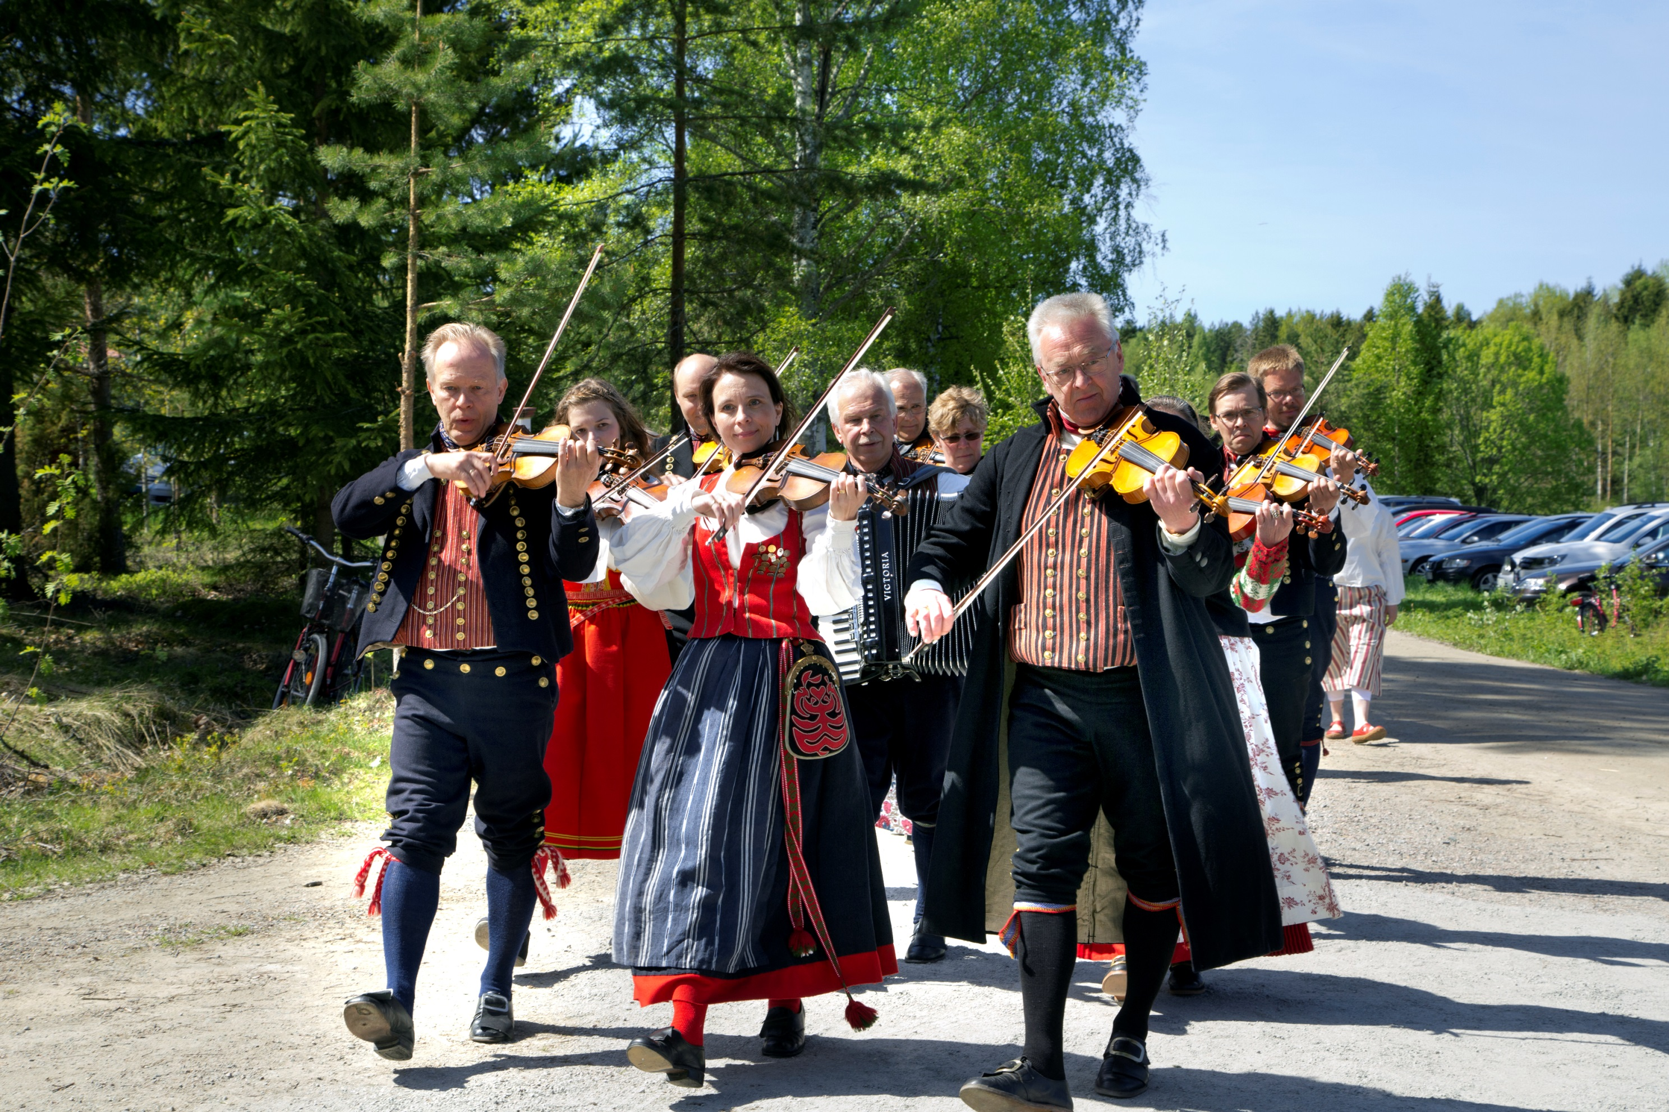
Who can apply?
Professionel creators
People who work, study, research or have another connections to world heritage sites.

Slide 8
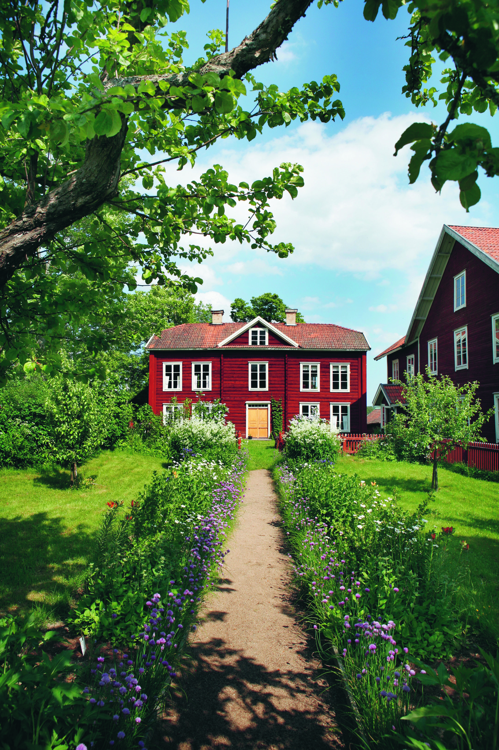
Live in one of the decorated farmhouses for one month to study, create, paint, research, compose, write etc
Call starts 2018
Decision in spring 2019
First period: summer 2019
All in purpose to widen the context of the Decorated Farmhouses of Hälsingland and World Heritage sites around the world.
Notes:
This is the world heritage farm Erik Anders, one of the seven world heritage farmhouses of Hälsingland on UNESCO´s list. The farmers of Hälsingland built grand farmsteads. Some call them wooden castles. This tradition to build large farms dates back to the 16- and 1700´s, as it has been described in travelogues from that time.

Slide 9
Welcome to apply!
www.varldsarvethalsingegardar.se
www.facebook.se/halsingegardar

