Slide 1
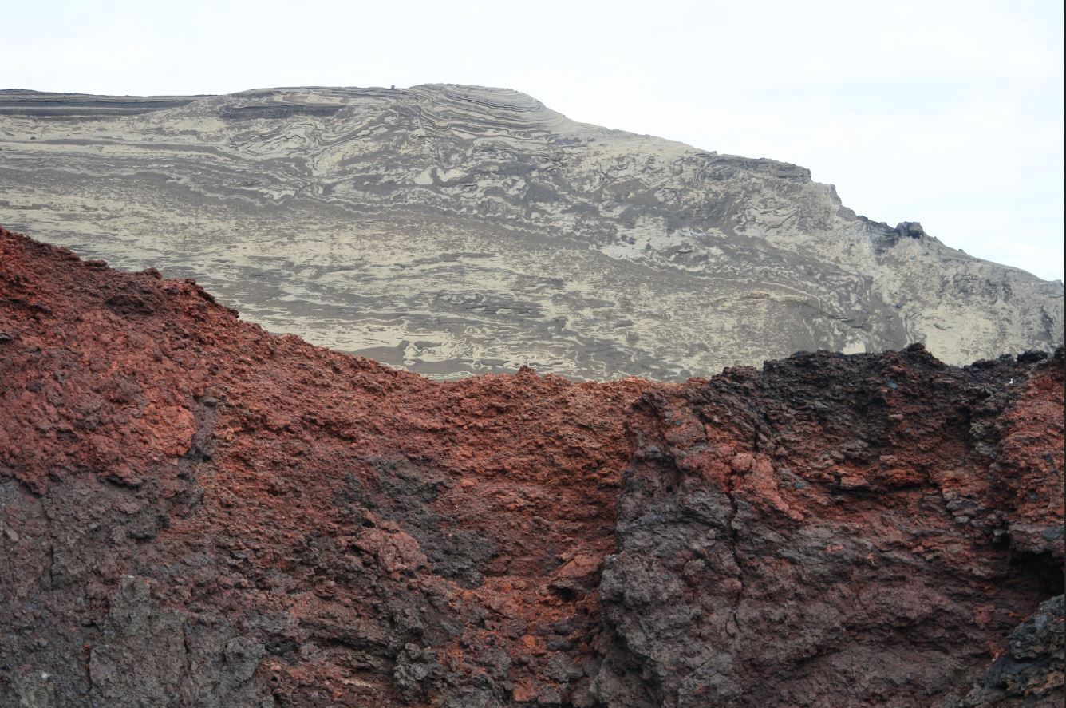
THE NWHA application to NCM -TEG (terrestrial ecosystem group)
Olafur A. Jonsson Surtsey - Iceland

Slide 2
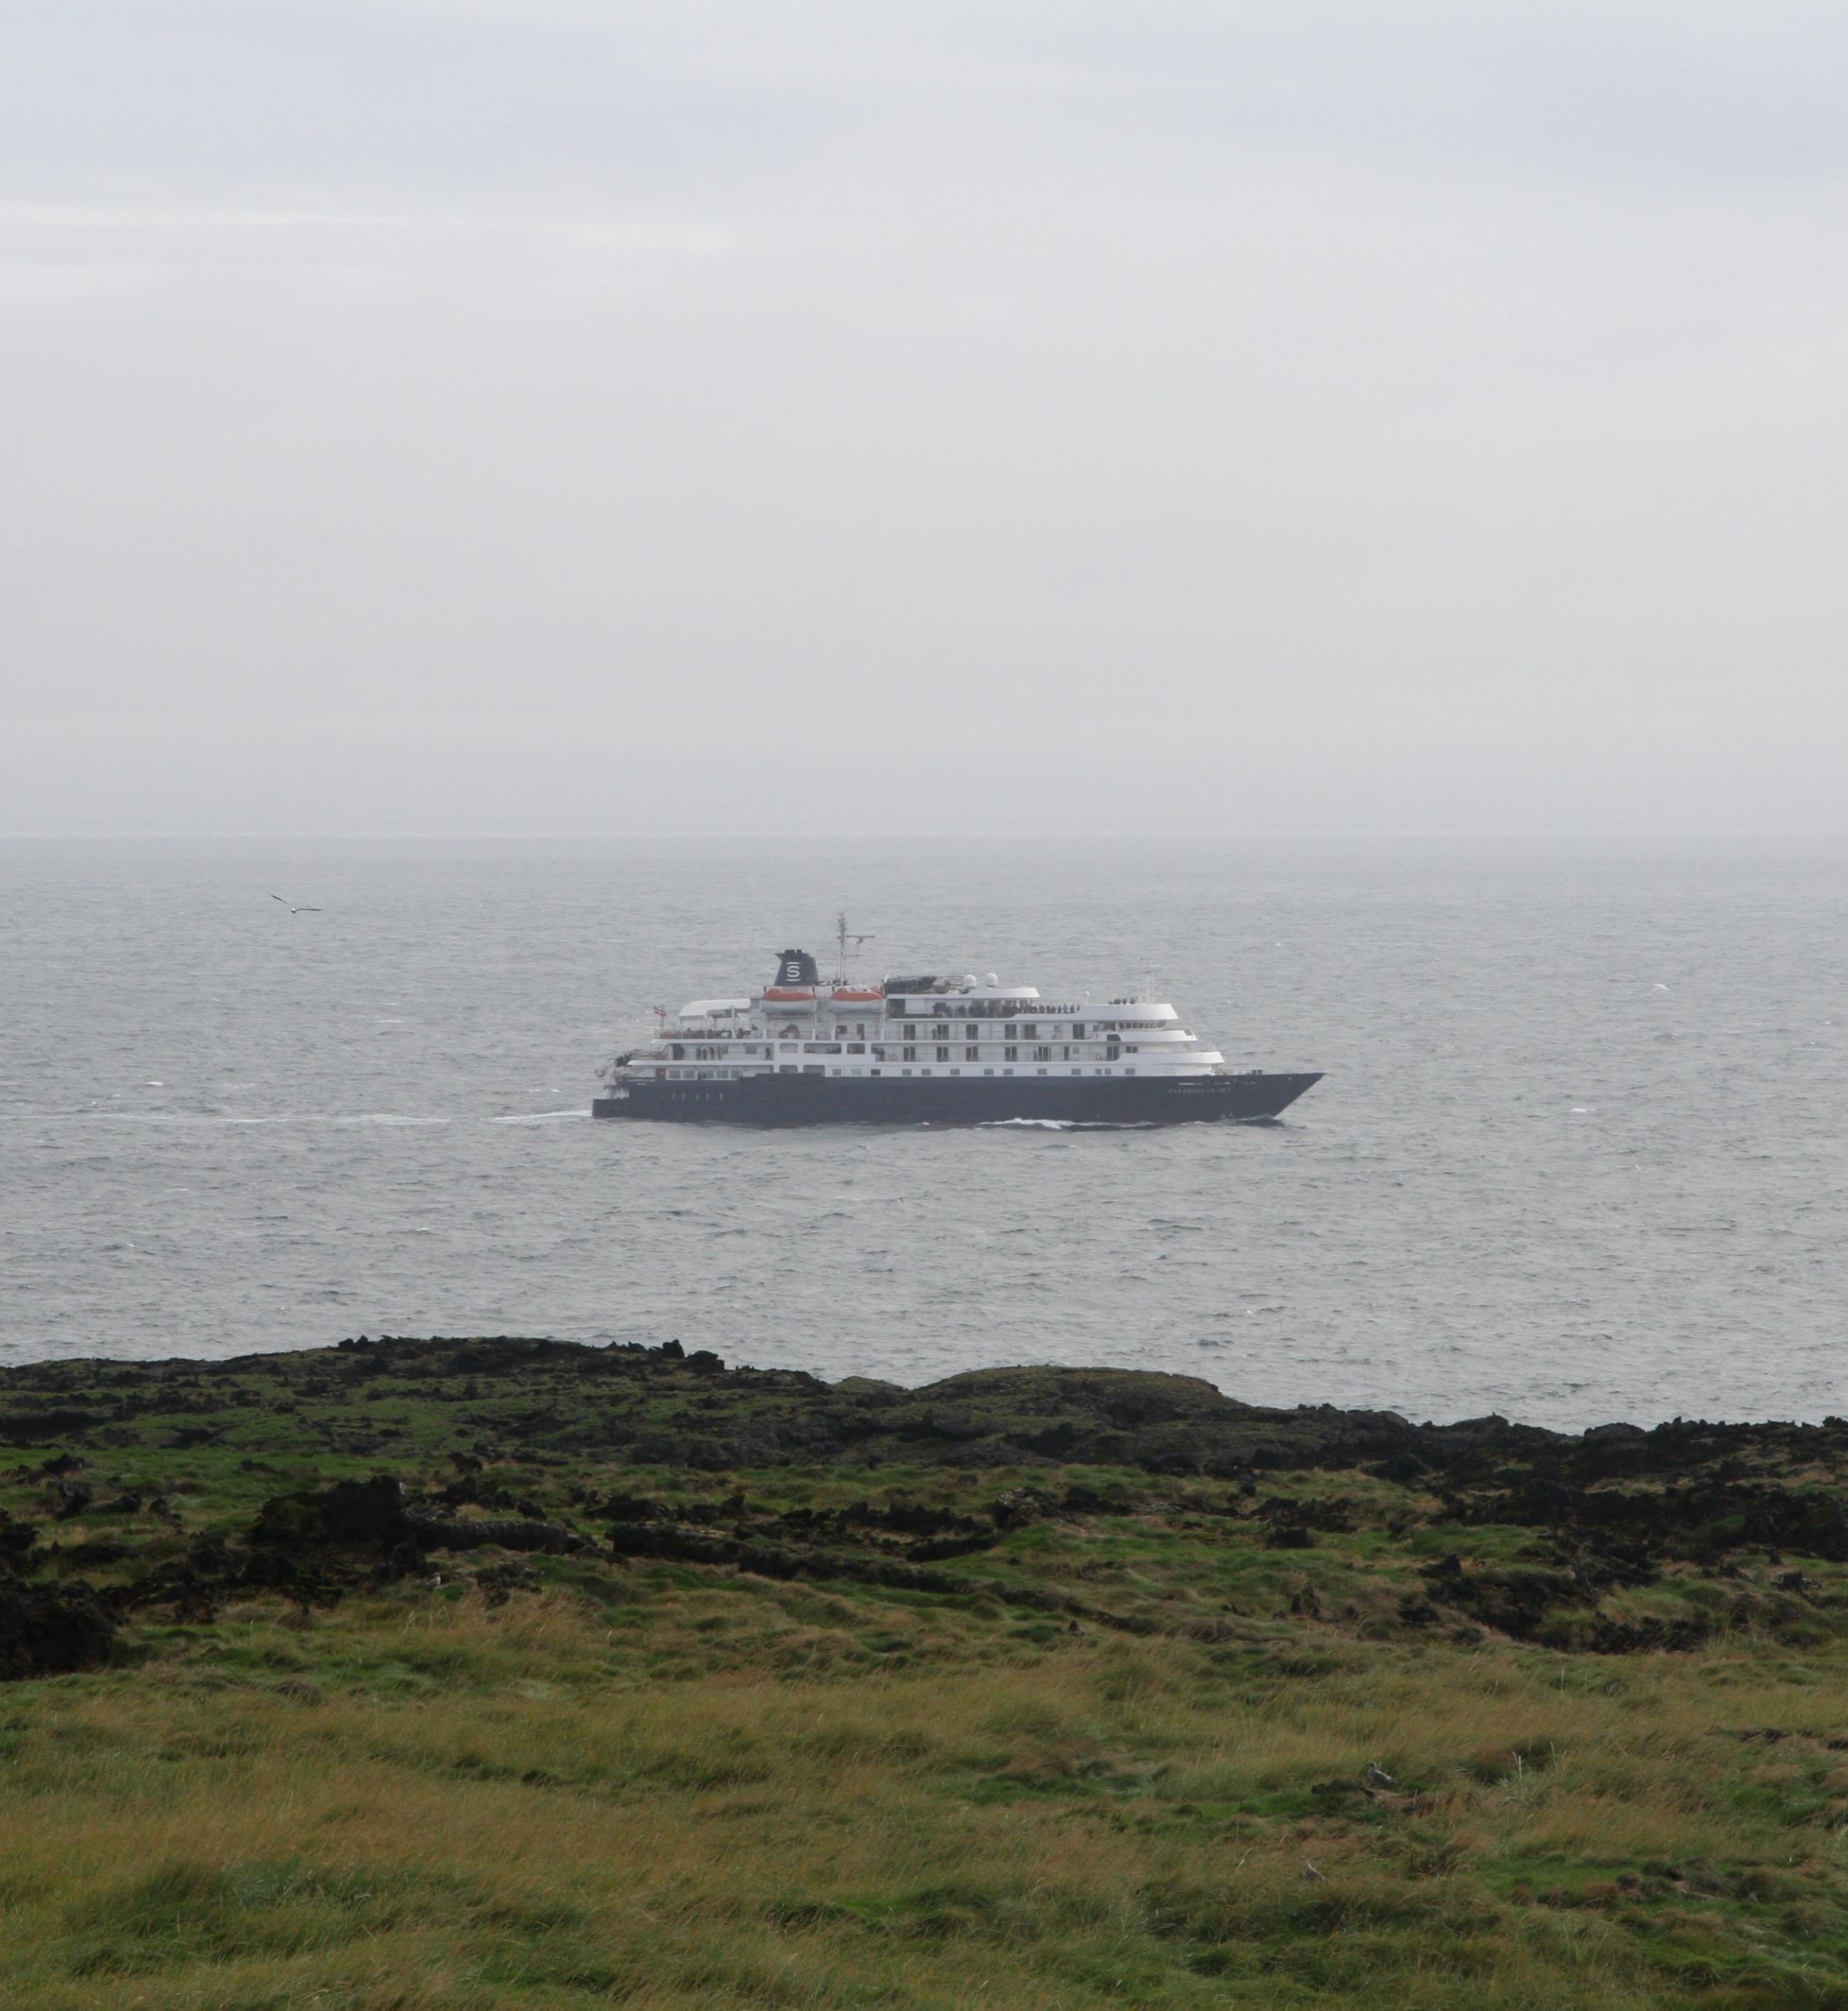
What is this project all about?
Title of project: „Den nordiske Verdensarv sem en modelregion for bæredygtig turisme.“
„The Nordic World Heritage as a model region of sustainable tourism“
The long term aims of the project are:
To address the impact of tourism on NWH sites.
To encourage, inspire and aid the NWH sites to develop sustainable tourism strategies
To improve the recreational carrying capacity of NWH sites.
To encourage partnerships on sustainable tourism across the Nordic borders.

Slide 3
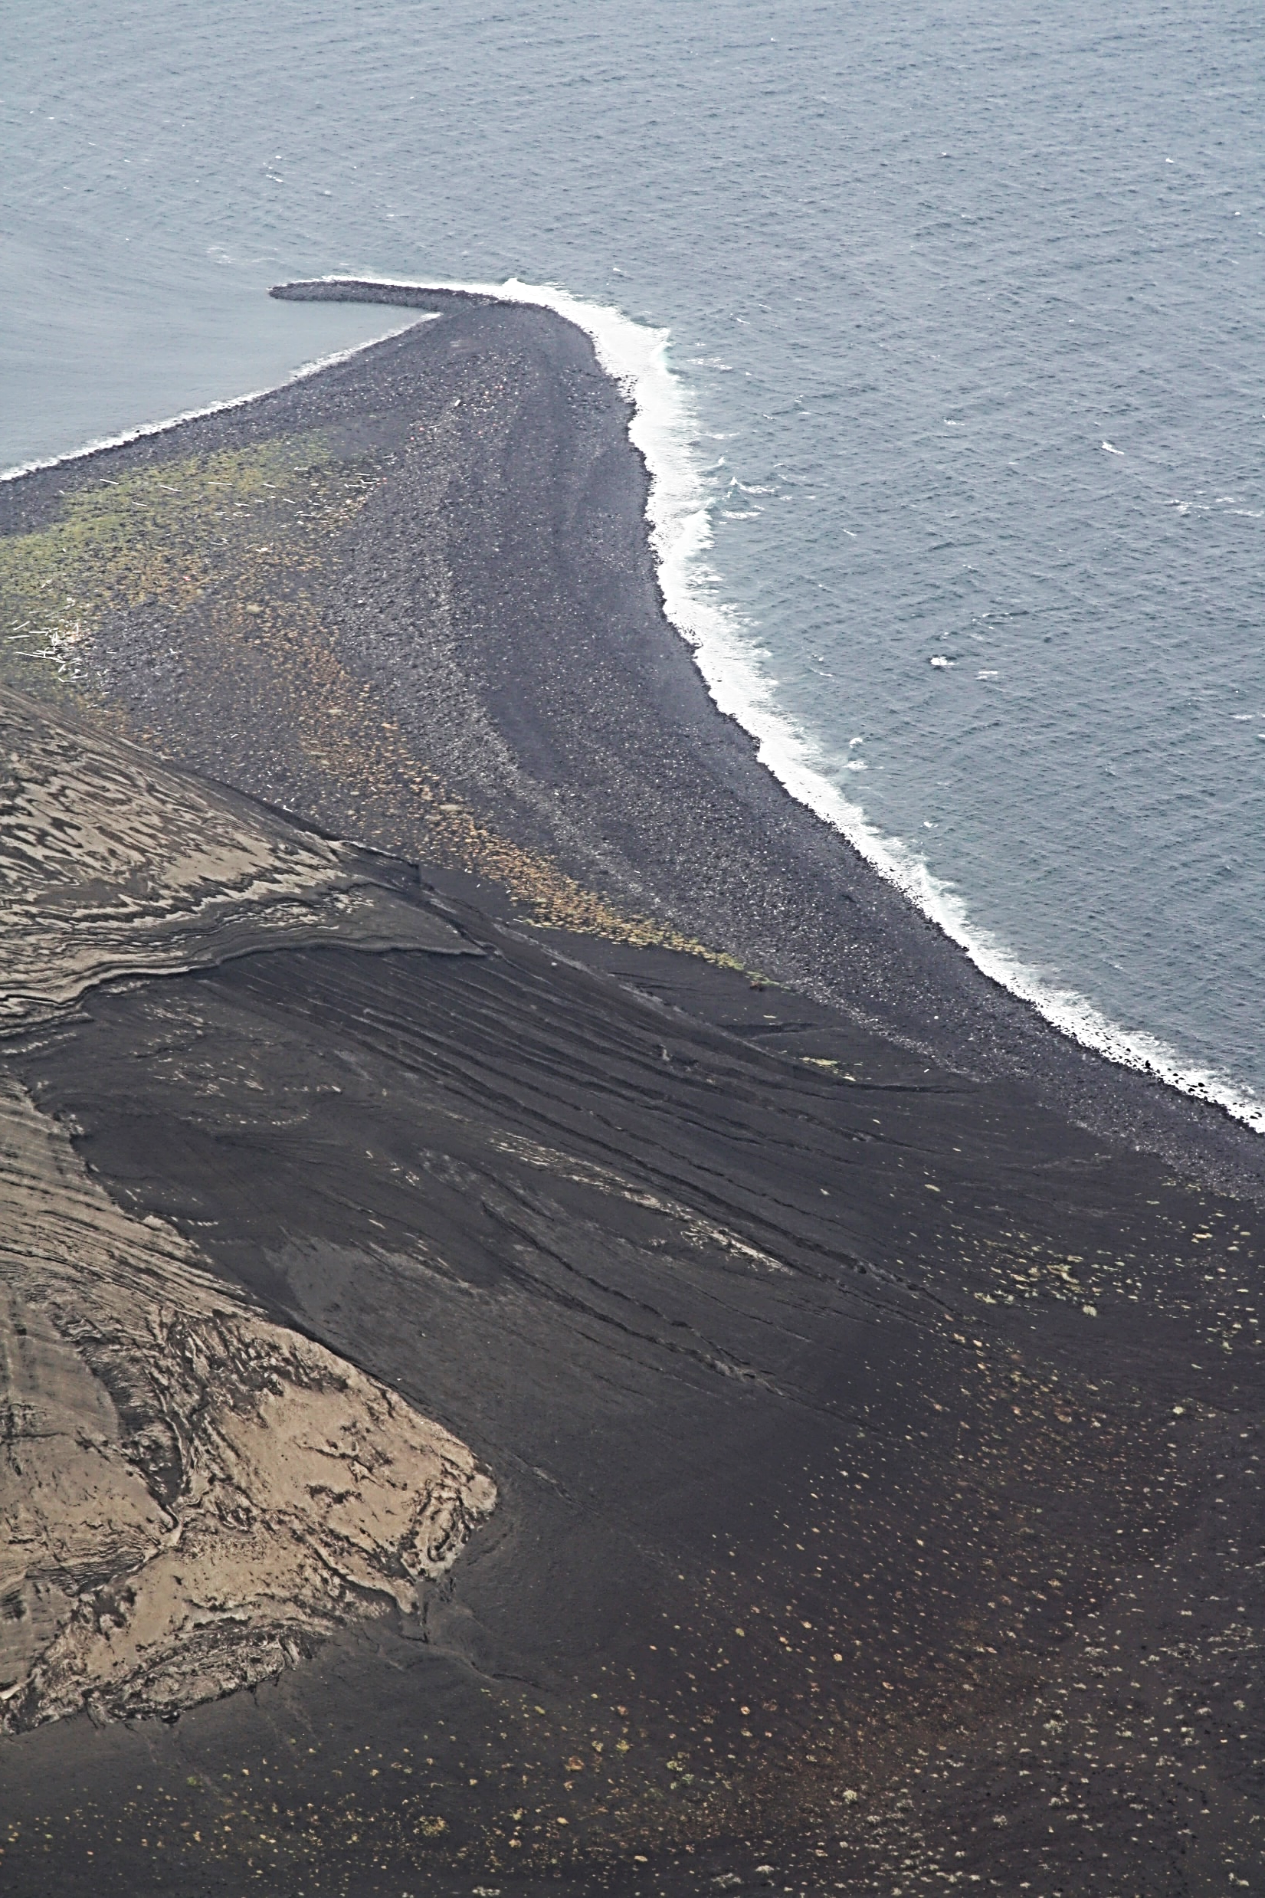
What will be the main outcome?
Knowledge through case research and surveys:
Focusing on sites‘ approach and practical experience
The use or non use of the UNESCO Sustainable Tourism Toolkit.
Best case examples – model sites?!
Workshop on the NWH 2019 conference:
discussing results as well as
developing new solution for promoting the toolkit
Debrief material presenting outcome
Promoting toolkit at site level

Slide 4
Who will do the job?
Project manager:
Louise Work Havelund, BARK Rådgivning (louise@b-a-r-k.dk)
Manager in charge
Birgitte Sidenius Bjerg Lamp
Other representatives:
Rita Johansen – Vega, Norway
Ólafur A. Jónsson – Surtsey, Iceland
Peter Debrine - UNESCO

Slide 5
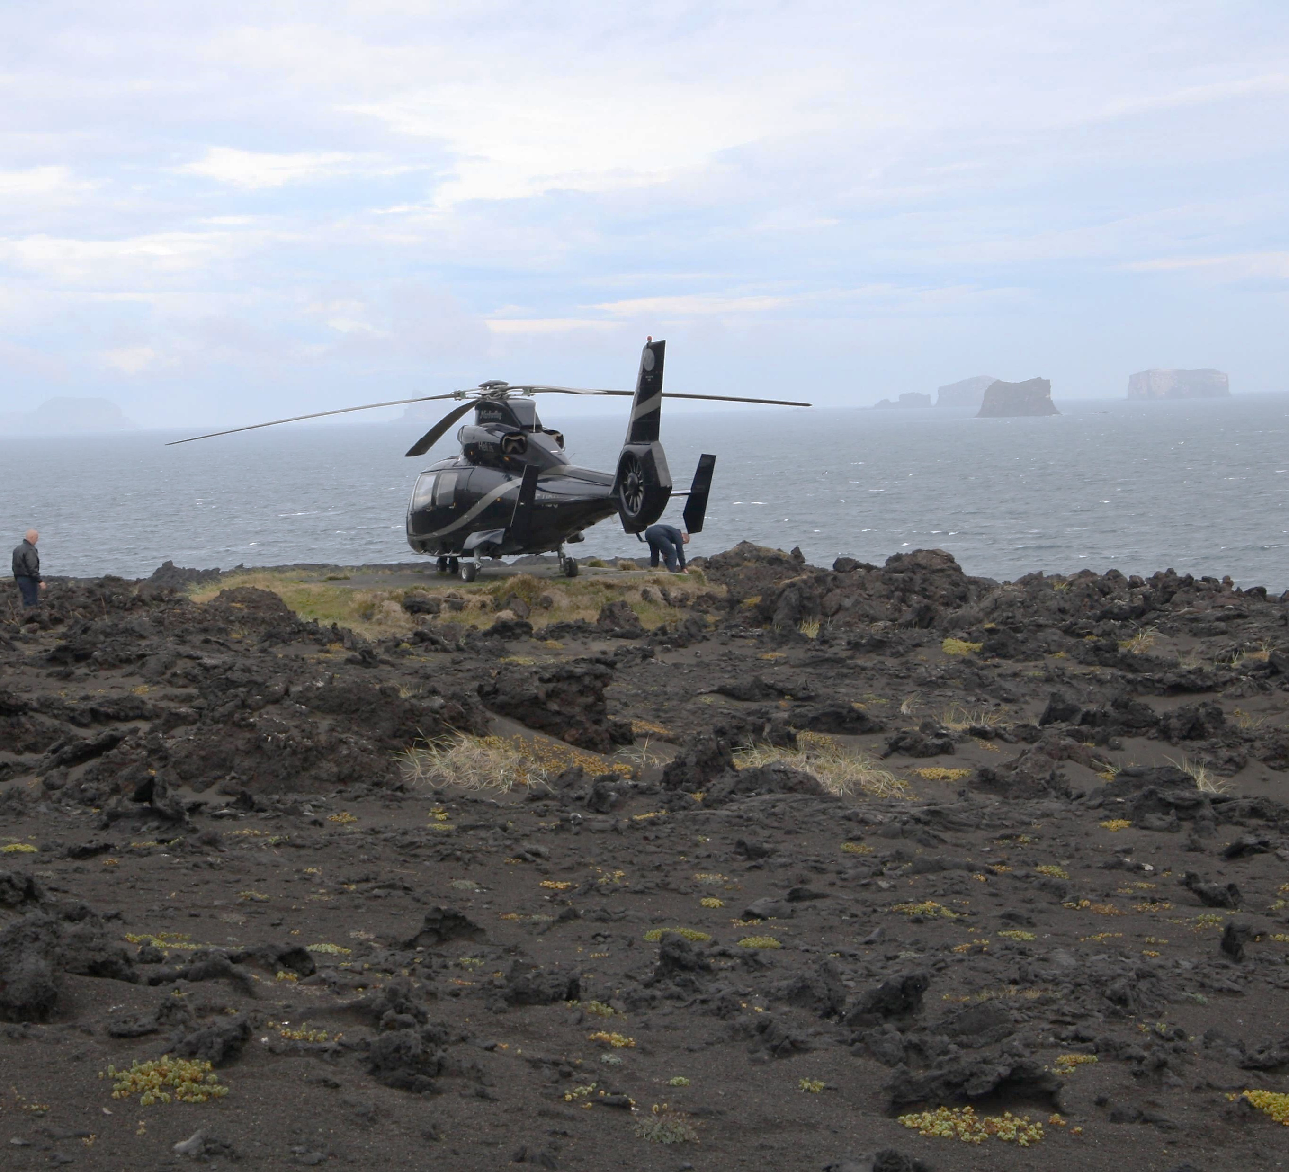
When and how?
Start of the project – if funding is acquired – Jan 2019
Timetable for the project in 2019:
January – June: Research and analysis (phase 1)
August – October: Conference workshop (phase 2)
October – November: Seminar meetings (phase 3)
November – December: Communication (phase 4)
December – January: Evaluation (phase 5)

