Slide 1
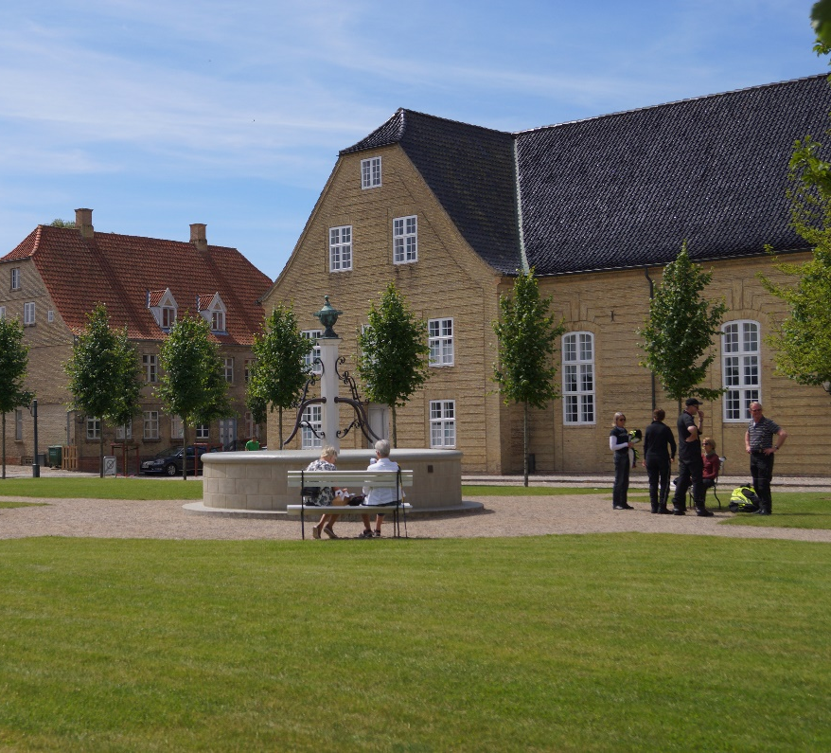
News from the NWHA – the board
The Board – who are we
The Vision of NWHA
Conference strategy
Homepage
NWHA Award
TEG-Project

Slide 2
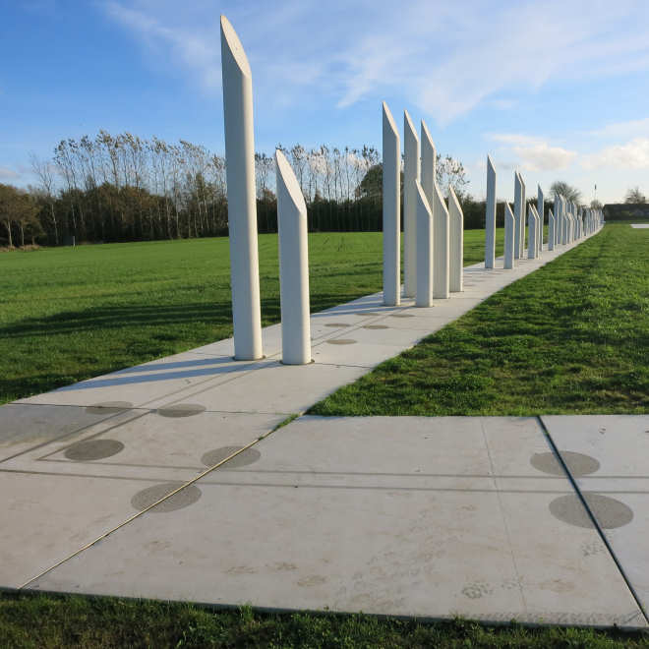
The Board
Norway (Odd Sletten & Rita
Johansen)
Sweden (Lena Landström &
Camilla Lugnet)
Finland (Jussi Telaranta &
Petteri Takkula)
Iceland (Ólafur A. Jónsson &
Einar Á.E. Sæmundsen
Denmark (Morten Teilmann-
Jørgensen & Birgitte Lamp)

Slide 3
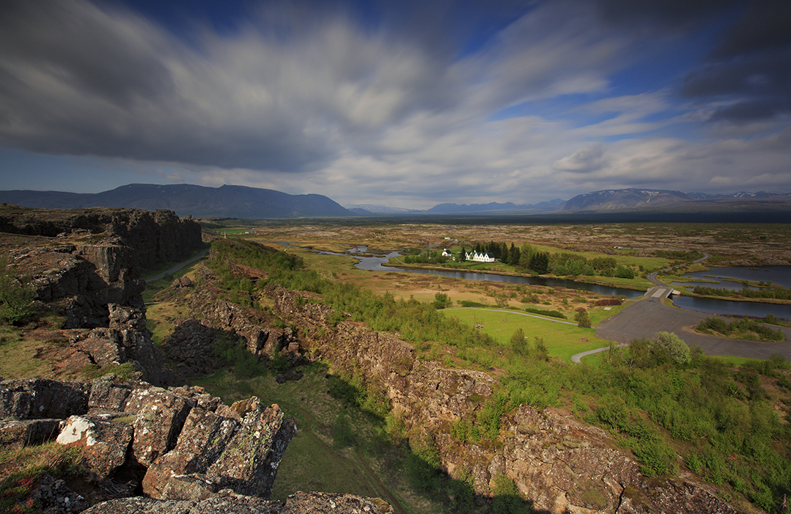
The vision
The Nordic World Heritage Association supports best practice in World Heritage Management across the Nordic countries – sharing knowledge and implementing the World Heritage Convention
Notes:
Besøgstal: Lige så godt som sidste år – der var den hidtil bedste
Guidede ture: Også pænt – efteruddannelse af guidekorpset + rollatorvandringer
Vielser: Ligger ligeledes fint, ift. sidste år, lyder det fra vores lokale giftefoged Finn Johannsen

Slide 4
Conference strategy
Extracts:
The members of the Nordic World Heritage Association alternately host the conference.
The annual conference is a major activity to fulfil the purpose and the vision of the Association.
The organizer is responsible for the programme and the actual running of the conference.
The Board of the Nordic World Heritage Association functions as an advisory Board to the organizers ensuring the long term development of the conferences.
The conference host/hosts for the coming year will give a brief presentation at the conference the year before.

