Slide 1
Virtual World Heritage Network

Slide 3
World Heritage farm Bortom Åa in Fågelsjö

Slide 4
Availability, accessability and new target groups

Slide 5
Creators and artists in collaboration

Slide 6
The culture commissioner of the EU Tibor Navracsisc

Slide 7
Exam project in industrial design, University of Gävle

Slide 9
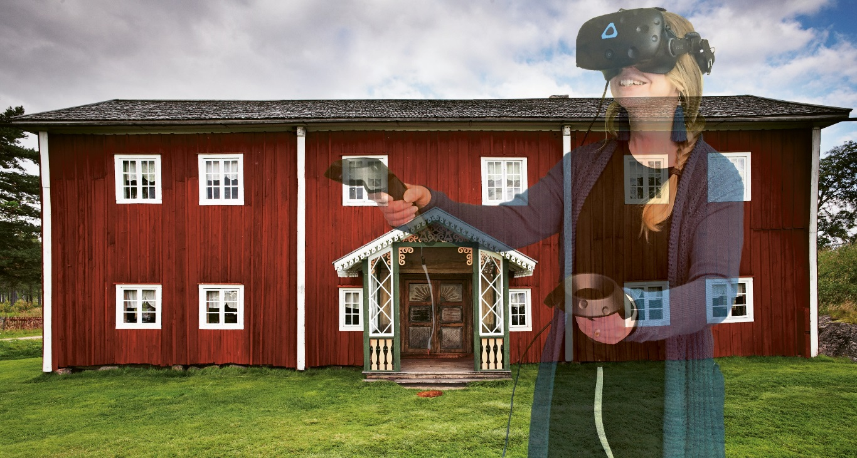
www.regiongavleborg.se/kultur
www.regiongavleborg.se/kultur/nyheter/gammelgarden-i-fagelsjo-som-virtuell-miljo/
www.varldsarvethalsingegardar.se
www.facebook.se/halsingegardar
www.storytech.se

