Slide 1

UNESCO World Heritage
Children
Learning through Play

Slide 2

UNESCO World Heritage
Only sites representing an outstanding universal value and meeting rigorous selection criteria, might be included on the World Heritage List.
In other words, we all have unique stories to tell -.
Important stories to tell to children and young people –
to bring forward our history, experience and knowledge which we have gained so far to the next generation.
So, how do we engage children?

Slide 3
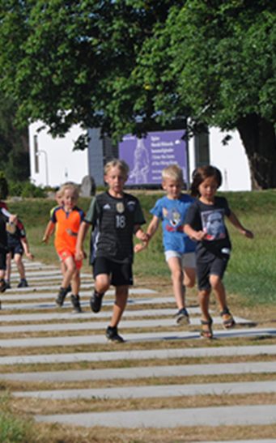
The Challenge
A ”day off-line, on-line, on-line, off-line, fast and busy”
An ”unknown” future, requiring new competencies and skills
How do we engage children in our story telling?

Slide 4
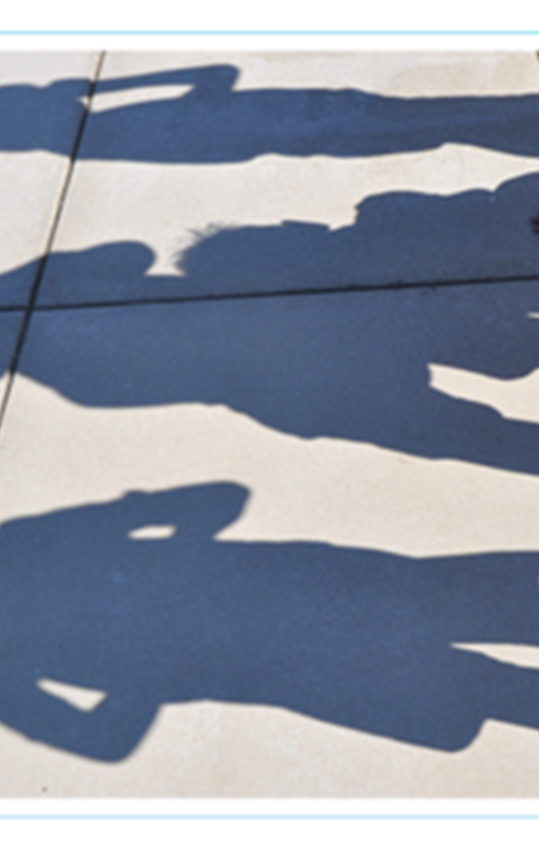
The Opportunity
We have unique stories to tell
Children are natural learners, curious and creative
Play is an effective way for children to engage and learn

Slide 5
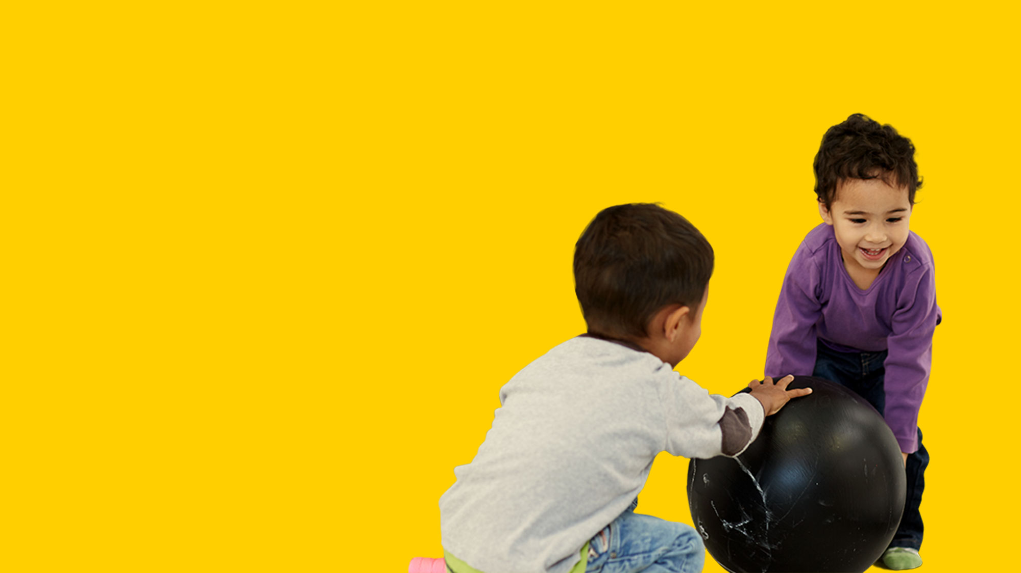
What is Play?

Slide 6
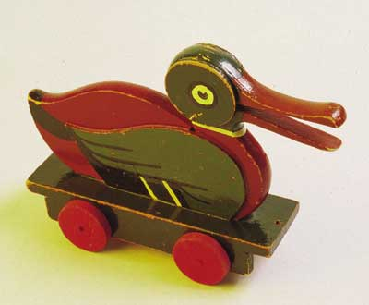
Build a Duck
45 seconds

Slide 7
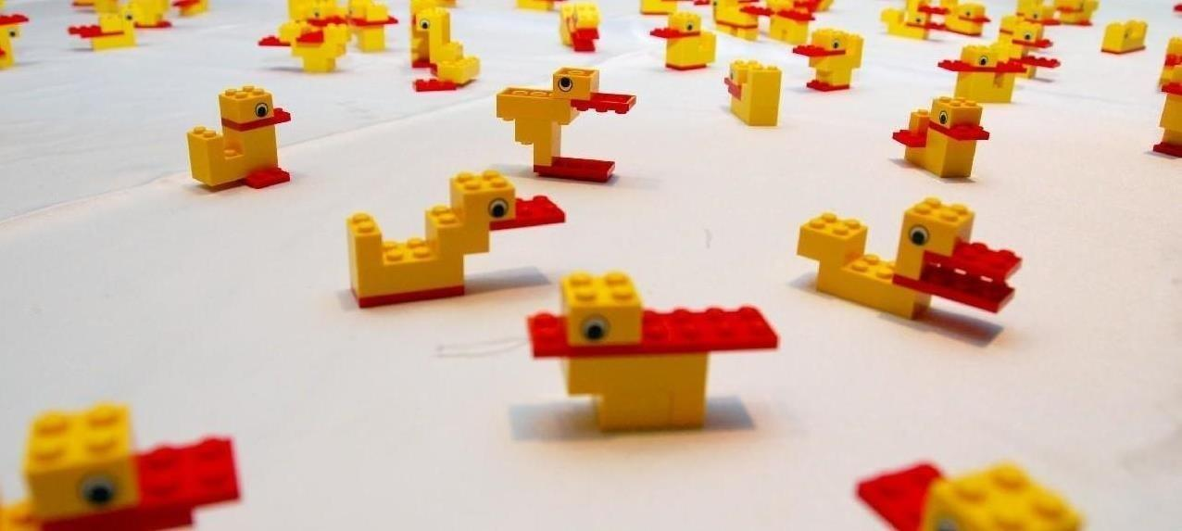

Slide 8
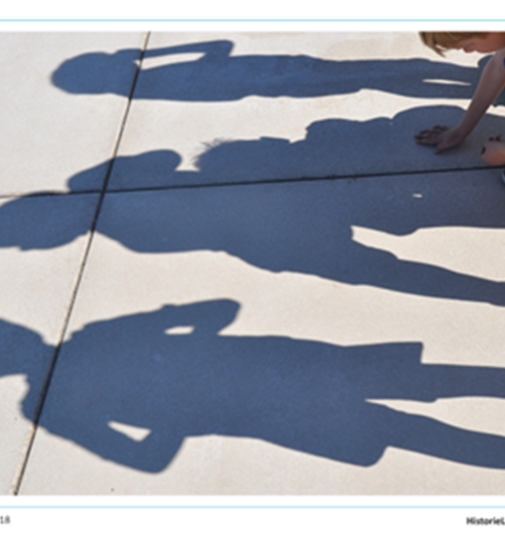
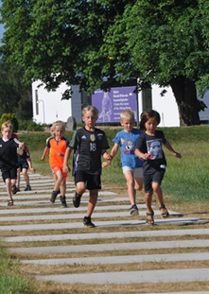
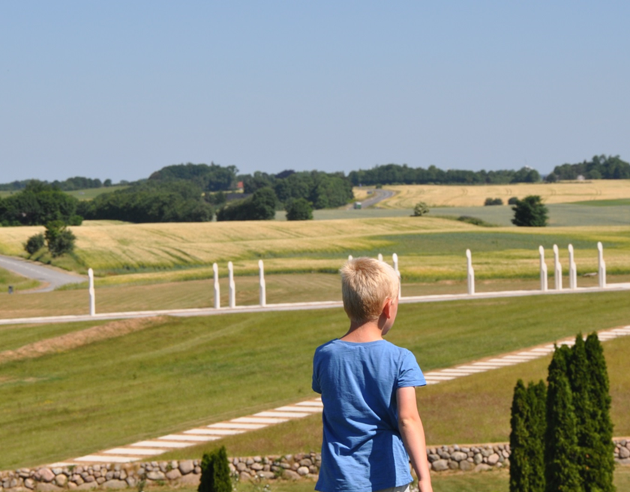
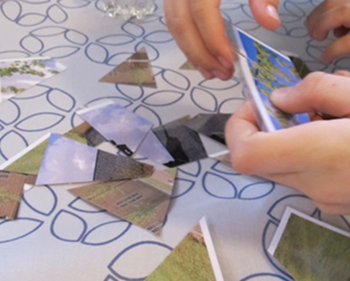
  What is so special about Play?

Slide 9

Learning through Play
emotional regulation
self-efficacy
self-regulation
visual search
long-term memory
symbolic representations
attention
kinesthetic awareness
mental imagery
spatial visualization
systems thinking
sensory-motor skills
executive functioning
mental rotation
visual perception
working memory
imitation
spatial abilities
adaptive social functioning
fine motor skills
perspective-taking
short-term memory
self-assessment
cognitive flexibility
Notes:
Key message 1: Let me give you are few examples of what happened while you were building the duck
Executive Functioning:
It’s fundamental for your ability to concentrate and to control yourself like when you are keeping attention to ask and avoiding distractions.
This is essential for problem-solving, like when you are dealing with a complex problem or in a task or situation with many different inputs, or information.
Symbolic Representation :
The ability to associate objects, actions or symbols with a particular meaning, like when you were looking for elements that had similarities with a duck.
Important for language development when understanding the meaning of letters and words and numbers in relationship to everyday objects.
Spatial abilities:
Thinking about and manipulating objects in 3-dimensions, like when visualizing inside your head what you wanted to build, and then manipulating the elements to make the duck.
This is essential for your ability to visualize and imagine a situation, and look at it from different directions, - and maybe even more critical, this plays a key role in mathematical thinking, when children learn to sort, count and quantify objects.
Self-regulation:
Most of you got a little stressed during this task, but as no-one failed.
Your ability to regulate your emotions and motivation, while setting yourself the goal of completing the duck and working yourself towards that goal, is called self-regulation.
Important for you to control and lead yourself when you are setting yourself a goal and trying to achieve it.
Key message 2:
Sometimes we consider these abilities like concentration, controlling yourself, visualizing ideas, understanding space for soft skills – things that are a by-product of learning.
Nothing could be more wrong, because these skills that you use when you are motivated to play and make things, are the ones that are critical problem-solving and creativity and even also the fundamental way of learning language, reading, writing and mathematics.
Transition to next HEADLINE
In the LEGO Foundation we have researched for some years together w leading universities and researcher
We wanted to develop guiding principles for playful experiences which support deeper learning.

Slide 10
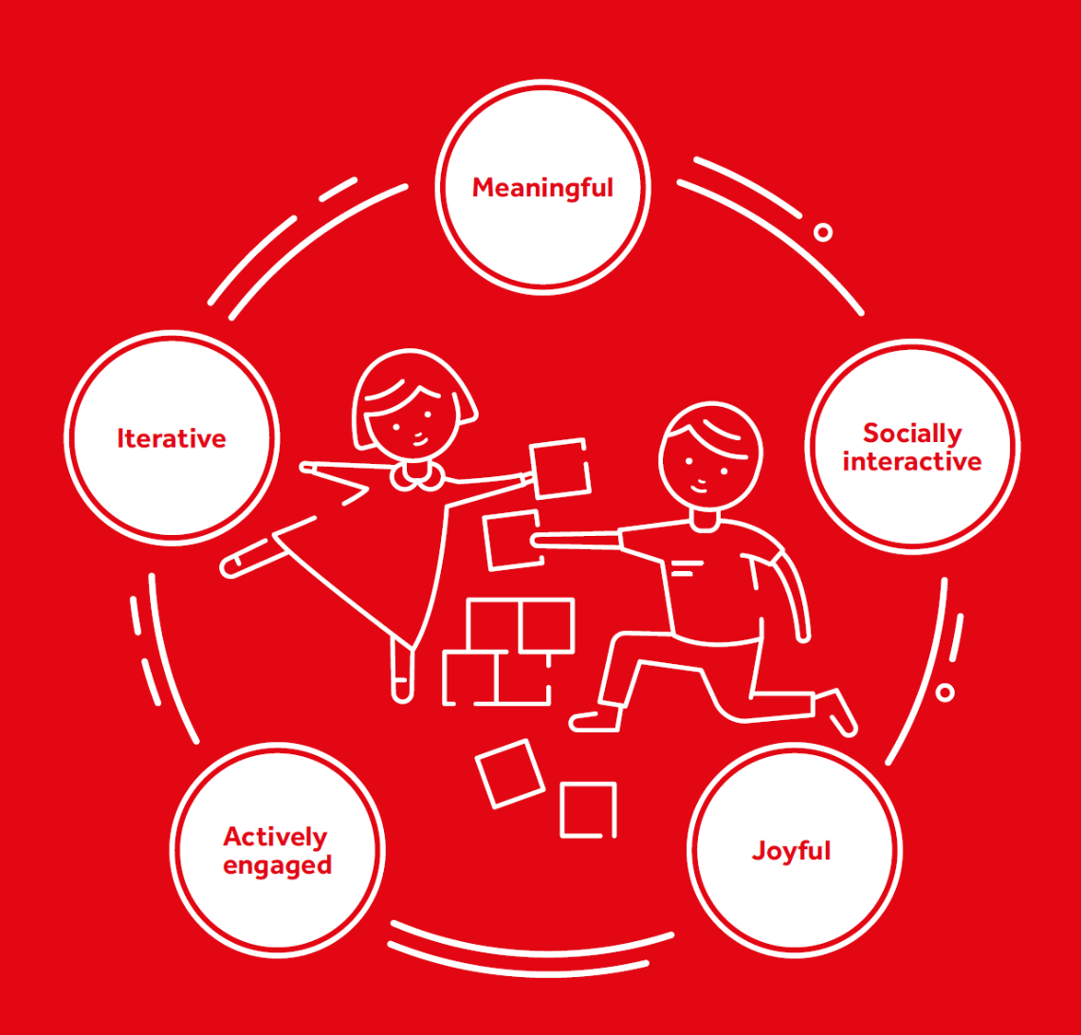
Playful experiences that supports deeper learning.
Joyful
Enjoying what you do by being open to new experiences, sparking curiosity and seeking new information.
Meaningful
Doing things that are relevant and meaningful with the ability to make sense and connect to own experiences.
Actively engaging
Being actively engaged and fully absorbed into something with your full body and senses.
Iterative
Iterating by experimenting, testing things out and trying different strategies.
Socially interactive
Being social by sharing ideas, getting feedback and collaborating on difficulties
”What we mean by Learning through Play”
LEGO Foundation 2017

Slide 11

Unique Stories

Slide 12

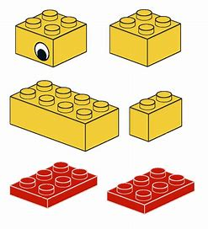
Unique stories – a great starter for playful experiences
UNESCO Sites have unigue stories to tell.
-at LEGO we study and learn from real stories in order to best possible model universes of play.
- unigue stories that leave room for fantasy, imagination, creativity, rolemodel-play.
Unique stories have a broad appeal.
historical universes as well as fantasy universes.
Strong stories can be directly related to curricula
Playful learning can be applied in many dimensions.
A LEGO lesson learned:
Stay true to your unique idea !
Use all your creativity and energy to tell your story again and again. – in new ways.

Slide 13
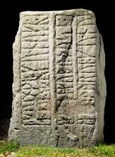
Engaging storytelling, where all senses are activated.
In recent years LEGO has often be criticised for bringing forward to much instruction in order to build correctly.
What about UNESCO sites?
Are you scripting your storytelling too tight?
Do you mix the hard facts with some scenarios and leave it with some open-ended questions?
Do you allow for creativity and reflection ?
Do you open for dialogue and engagement?
Do you challenge children, their parents and grand-parents?

Slide 14
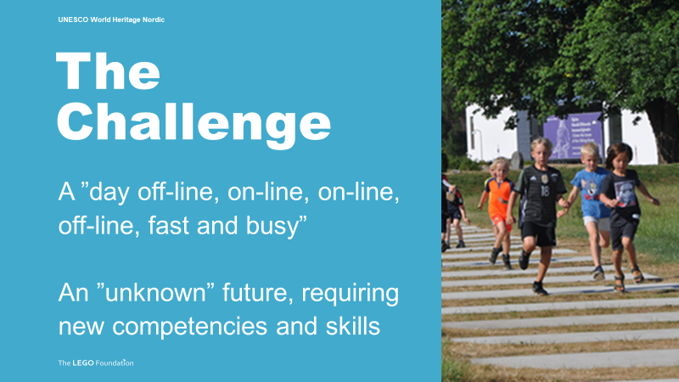
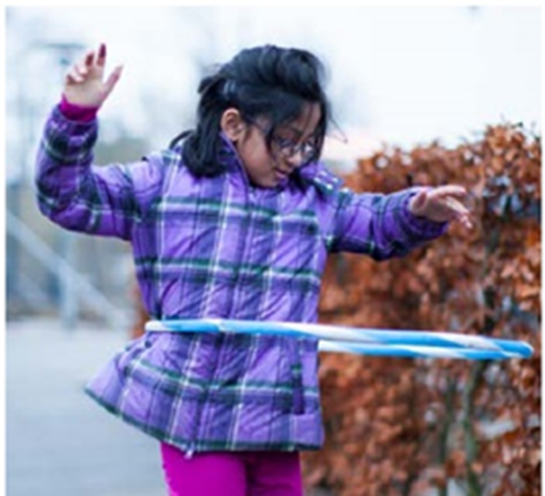
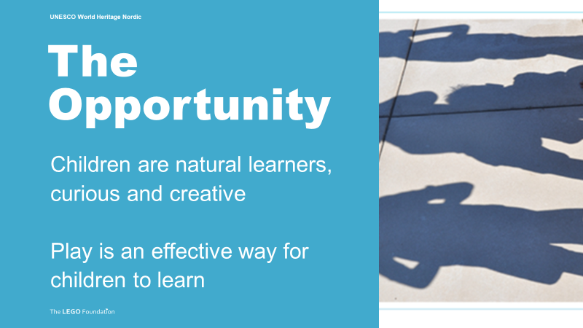

Slide 15

Play matters
Thank you

